Slide 1
Lecture 5: ODE
Omer Bromberg
omerbr@tauex.tau.ac.il
Winter 2025/6
Modified from lecture notes by Cyrus Dreyer & Michael Zingale

Slide 2
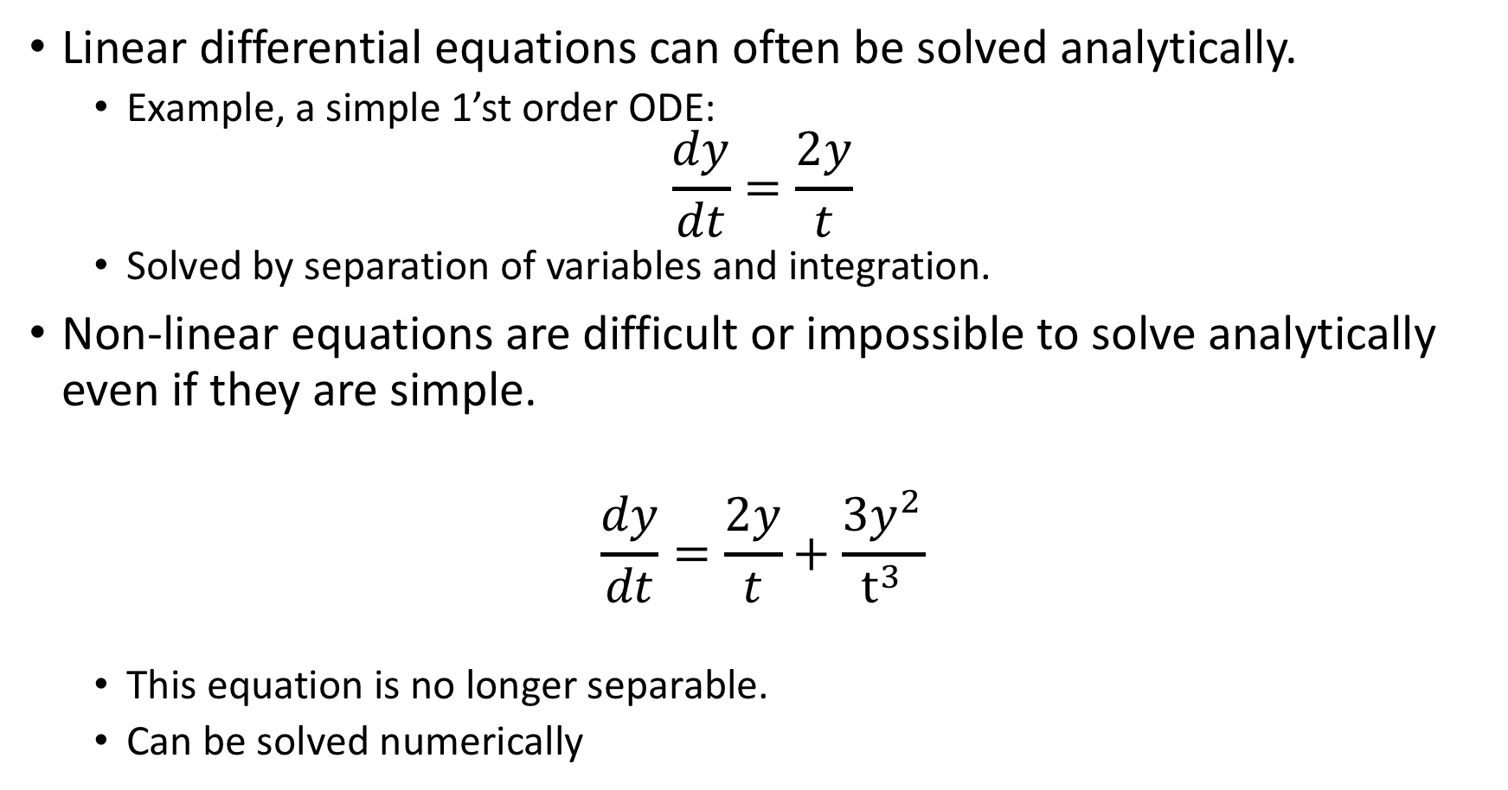
Ordinary differential equations (Newman Ch. 8)
Linear differential equations can often be solved analytically.
Example, a simple 1’st order ODE:
$$\frac{dy}{dt}=\frac{2y}{t}$$
Solved by separation of variables and integration.
Non-linear equations are difficult or impossible to solve analytically even if they are simple.
$$\frac{dy}{dt}=\frac{2y}{t}+\frac{3y^{2}}{t^{3}}$$
This equation is no longer separable.
Can be solved numerically

Slide 3
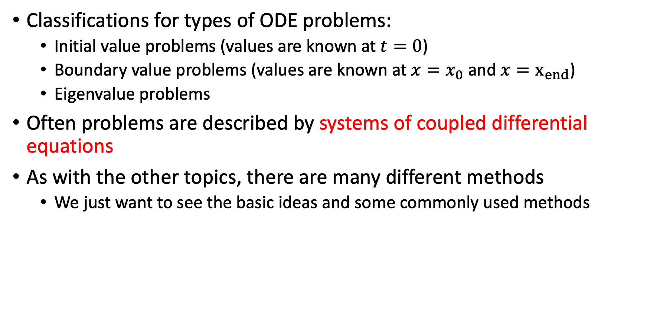
Ordinary differential equations (Newman Ch. 8)
Classifications for types of ODE problems:
Initial value problems (values are known at $t=0$)
Boundary value problems (values are known at $x=x_{0}$ and $x=x_{end}$)
Eigenvalue problems
Often problems are described by systems of coupled differential equations
As with the other topics, there are many different methods
We just want to see the basic ideas and some commonly used methods

Slide 4
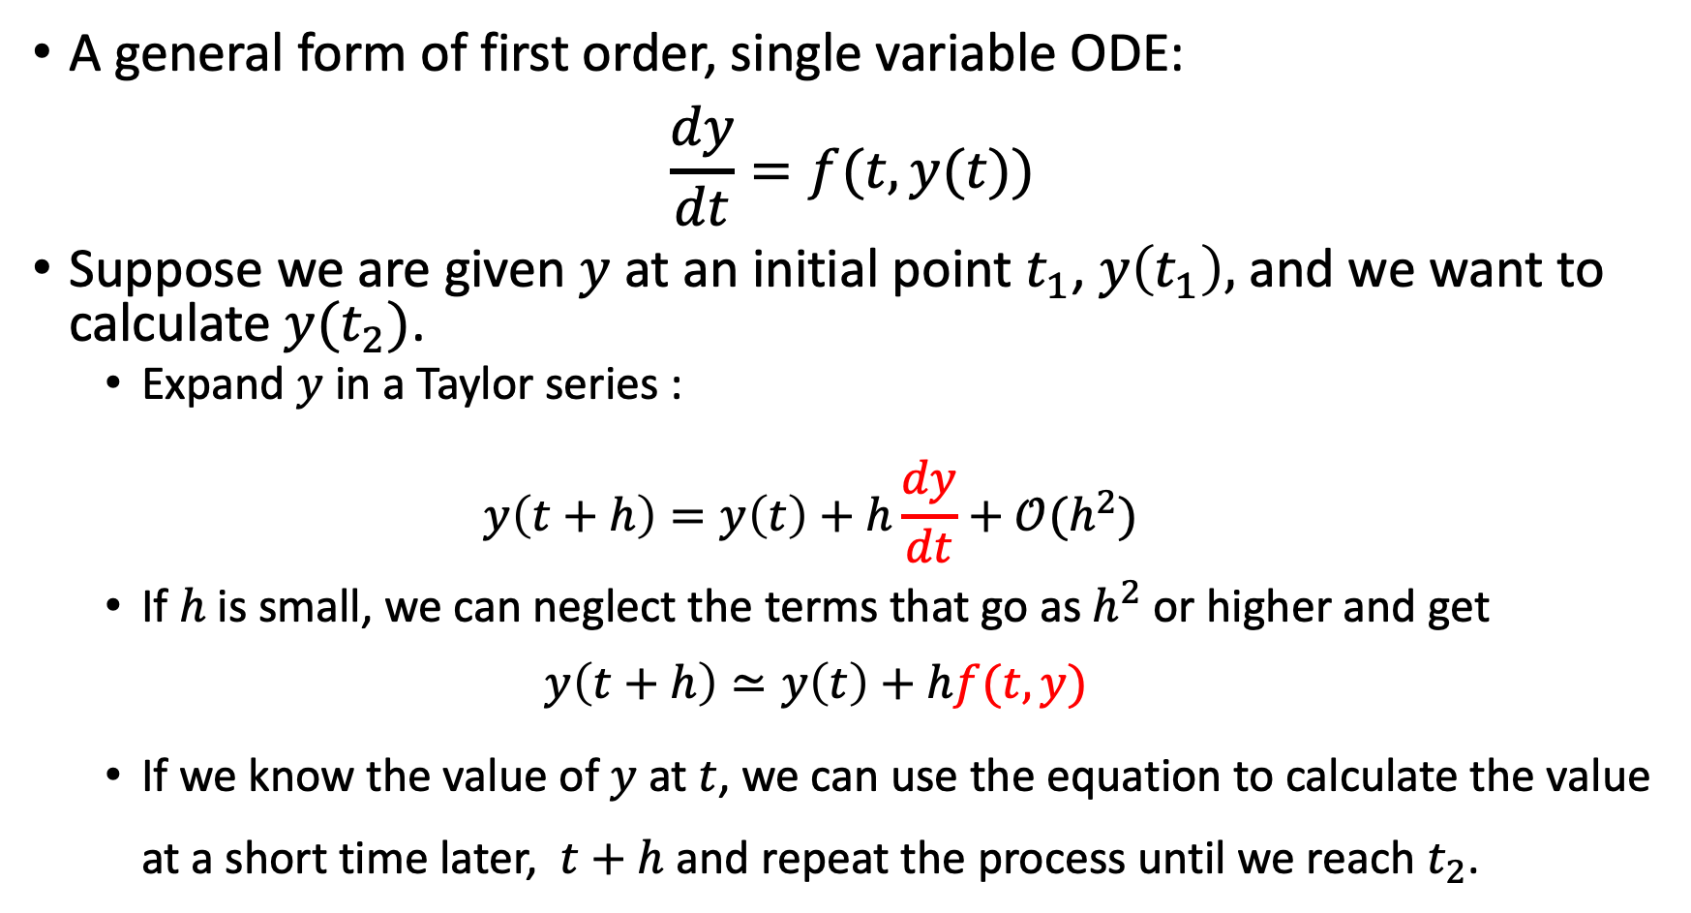
Euler method - 1’st order Runge-Kutta.
A general form of first order, single variable ODE:
$$\frac{dy}{dt}=f(t, y(t))$$
Suppose we are given $y$ at an initial point $t_{1}$, $y\left(t_{1}\right),$ and we want to calculate $y(t_{2})$.
Expand $y$ in a Taylor series :
$$y\left(t+h\right)=y\left(t\right)+h\frac{dy}{dt}+𝒪(h^{2})$$
If $h$ is small, we can neglect the terms that go as $h^{2}$ or higher and get
$$y\left(t+h\right)≃y\left(t\right)+hf(t,y)$$
If we know the value of $y$ at $t$, we can use the equation to calculate the value at a short time later, $t+h$ and repeat the process until we reach $t_{2}$.

Slide 5
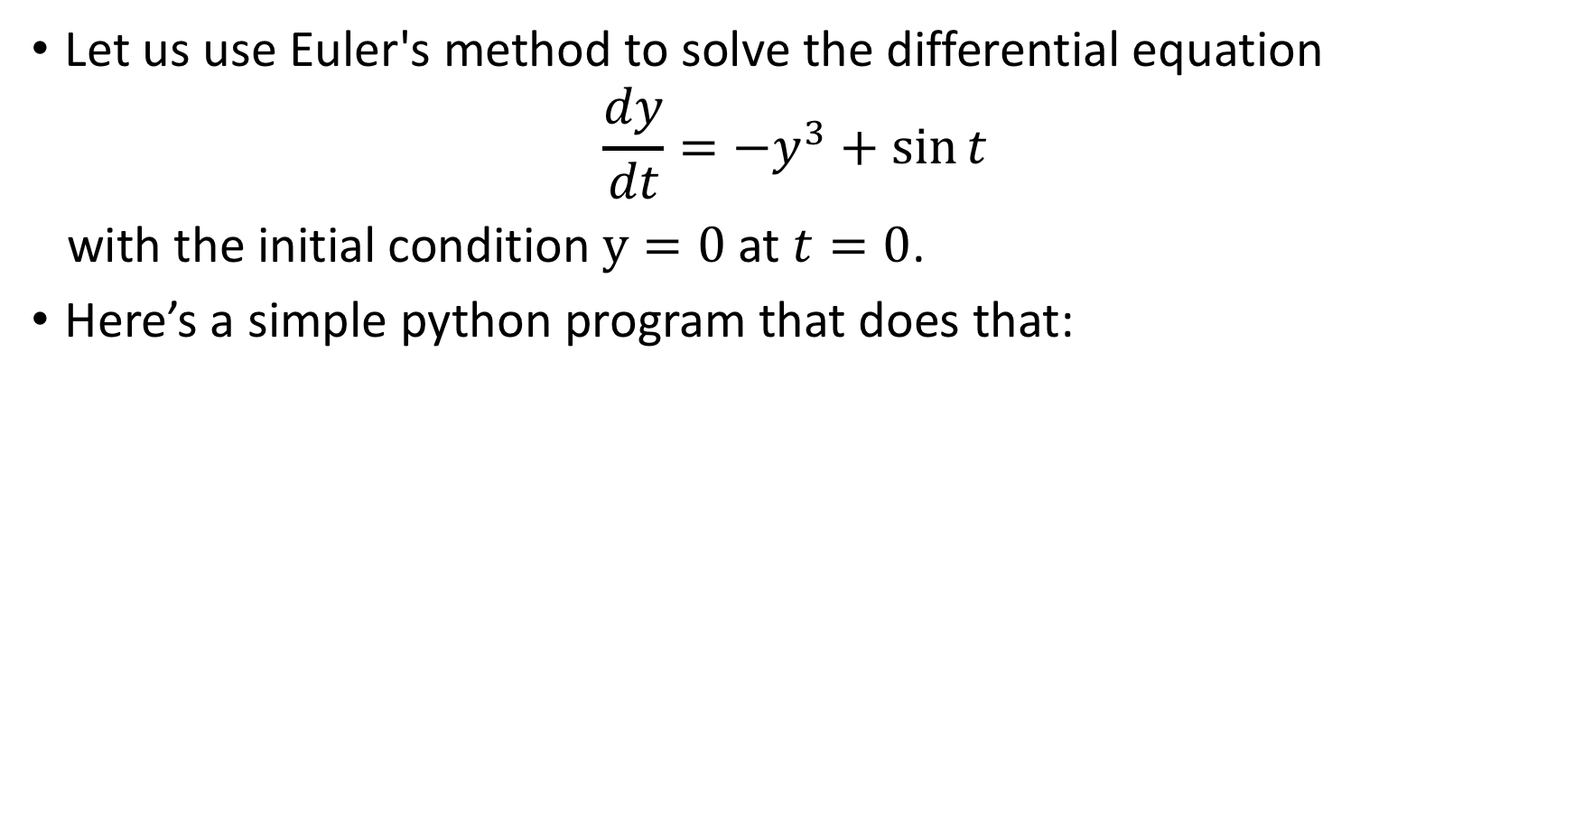
Euler method example
Let us use Euler's method to solve the differential equation
$$\frac{dy}{dt}=−y^{3}+\sin{t}$$
with the initial condition $y=0$at $t=0$.
Here’s a simple python program that does that:

Slide 6
from math import sin from numpy import arange from pylab import plot, xlabel, ylabel , show
def f(y,t):
return -y**3 + np.sin(t)
a = 0.0 # Start of the interval
b = 10.0 # End of the interval
N = 1000 # Number of steps
h = (b-a)/N # Size of a single step
y = 0.0 # Initial condition
tpoints = np.arange(a,b,h) # The grid array
ypoints = [] # The points array
for t in tpoints:
ypoints.append(y)
y += h*f(y,t) # Take a step
y(t)

Slide 7
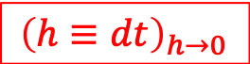
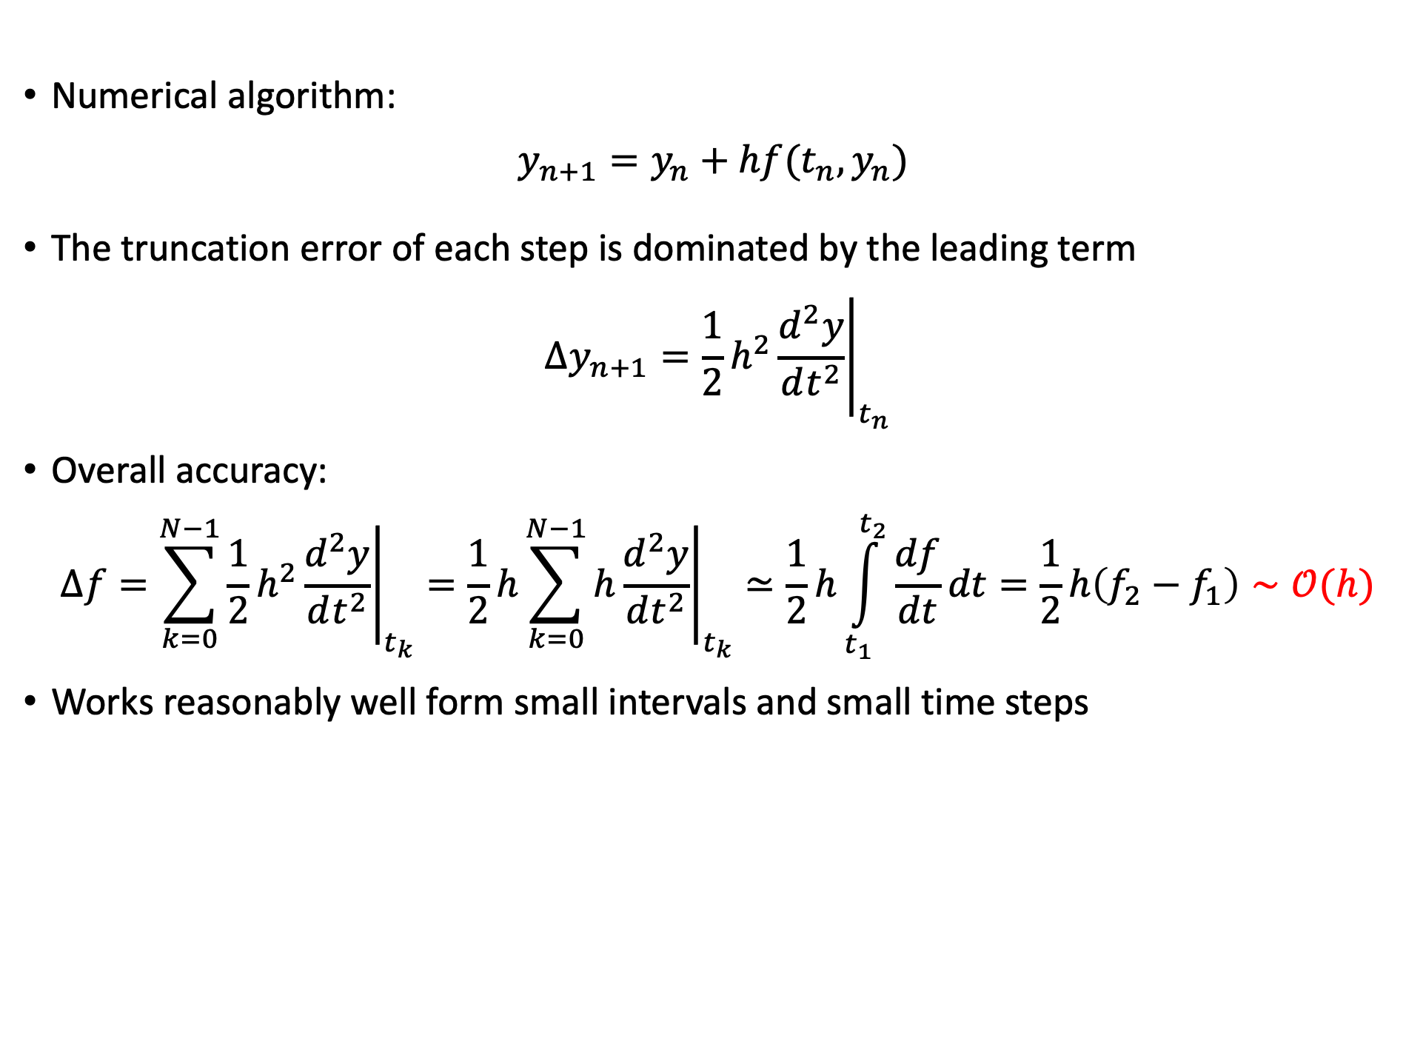
Errors in Euler method
Numerical algorithm:
$$y_{n+1}=y_{n}+hf(t_{n},y_{n})$$
The truncation error of each step is dominated by the leading term
$$Δy_{n+1}=\frac{1}{2}h^{2}{\left.\frac{d^{2}y}{dt^{2}}\right|}_{t_{n}}$$
Overall accuracy:
$$Δf=\sum_{k=0}^{N−1}{\frac{1}{2}h^{2}{\left.\frac{d^{2}y}{dt^{2}}\right|}_{t_{k}}}=\frac{1}{2}h\sum_{k=0}^{N−1}{h{\left.\frac{d^{2}y}{dt^{2}}\right|}_{t_{k}}}≃\frac{1}{2}h\int_{t_{1}}^{t_{2}}{\frac{df}{dt}dt=\frac{1}{2}h\left(f_{2}−f_{1}\right)}∼𝒪(h)$$
Works reasonably well form small intervals and small time steps
$${\left(h≡dt\right)}_{h→0}$$

Slide 8
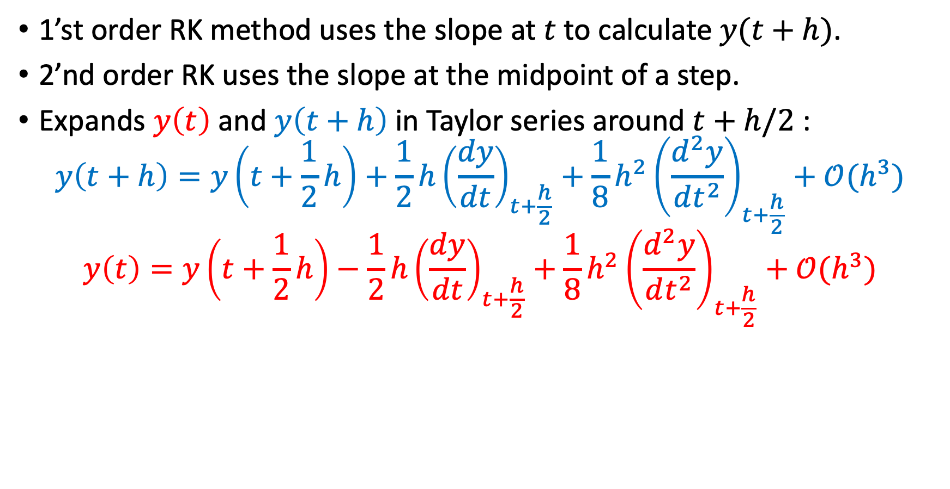
2’st order Runge-Kutta
1’st order RK method uses the slope at $t$ to calculate $y(t+h)$.
2’nd order RK uses the slope at the midpoint of a step.
Expands $y\left(t\right)$ and $y\left(t+h\right)$in Taylor series around $t+h/2$ :
$$y\left(t+h\right)=y\left(t+\frac{1}{2}h\right)+\frac{1}{2}h{\left(\frac{dy}{dt}\right)}_{t+\frac{h}{2}}+\frac{1}{8}h^{2}{\left(\frac{d^{2}y}{dt^{2}}\right)}_{t+\frac{h}{2}}+𝒪(h^{3})$$
$$y\left(t\right)=y\left(t+\frac{1}{2}h\right)−\frac{1}{2}h{\left(\frac{dy}{dt}\right)}_{t+\frac{h}{2}}+\frac{1}{8}h^{2}{\left(\frac{d^{2}y}{dt^{2}}\right)}_{t+\frac{h}{2}}+𝒪(h^{3})$$

Slide 9
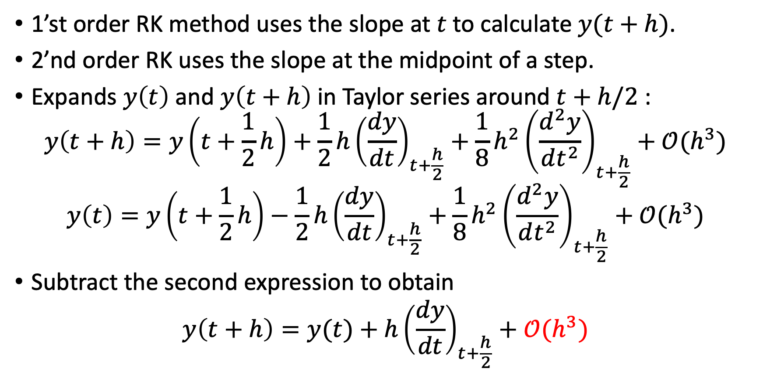
2’st order Runge-Kutta
1’st order RK method uses the slope at $t$ to calculate $y(t+h)$.
2’nd order RK uses the slope at the midpoint of a step.
Expands $y\left(t\right)$ and $y\left(t+h\right)$in Taylor series around $t+h/2$ :
$$y\left(t+h\right)=y\left(t+\frac{1}{2}h\right)+\frac{1}{2}h{\left(\frac{dy}{dt}\right)}_{t+\frac{h}{2}}+\frac{1}{8}h^{2}{\left(\frac{d^{2}y}{dt^{2}}\right)}_{t+\frac{h}{2}}+𝒪(h^{3})$$
$$y\left(t\right)=y\left(t+\frac{1}{2}h\right)−\frac{1}{2}h{\left(\frac{dy}{dt}\right)}_{t+\frac{h}{2}}+\frac{1}{8}h^{2}{\left(\frac{d^{2}y}{dt^{2}}\right)}_{t+\frac{h}{2}}+𝒪(h^{3})$$
Subtract the second expression to obtain
$$y\left(t+h\right)=y(t)+h{\left(\frac{dy}{dt}\right)}_{t+\frac{h}{2}}+𝒪(h^{3})$$
-

Slide 10
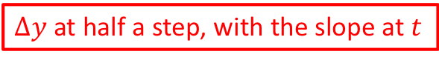
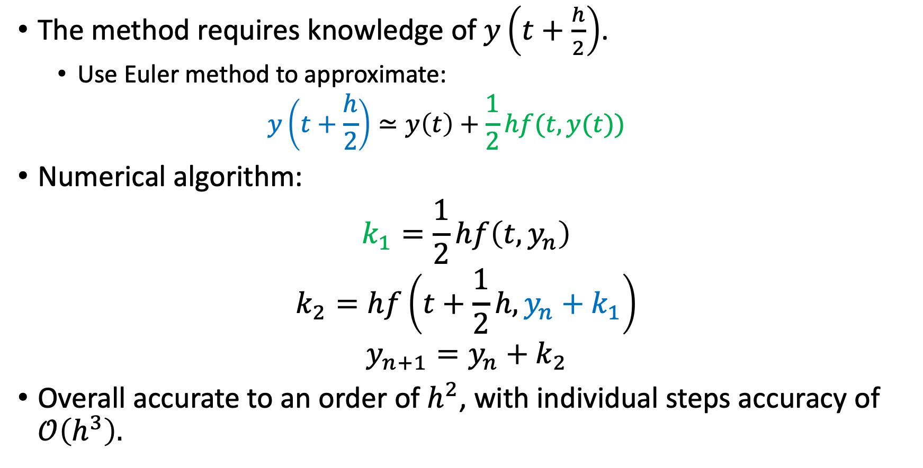
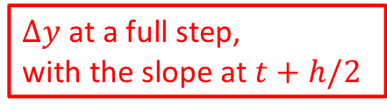
2’st order Runge-Kutta
The method requires knowledge of $y\left(t+\frac{h}{2}\right)$.
Use Euler method to approximate:
$$y\left(t+\frac{h}{2}\right)≃y\left(t\right)+\frac{1}{2}hf(t,y(t))$$
Numerical algorithm:
$$k_{1}=\frac{1}{2}hf\left(t,y_{n}\right)$$
$$k_{2}=hf\left(t+\frac{1}{2}h, y_{n}+k_{1}\right)$$
$$y_{n+1}=y_{n}+k_{2}$$
Overall accurate to an order of $h^{2}$, with individual steps accuracy of $𝒪\left(h^{3}\right).$
$Δy$ at half a step, with the slope at $t$
$Δy$ at a full step,
with the slope at $t+h/2$
The step

Slide 11
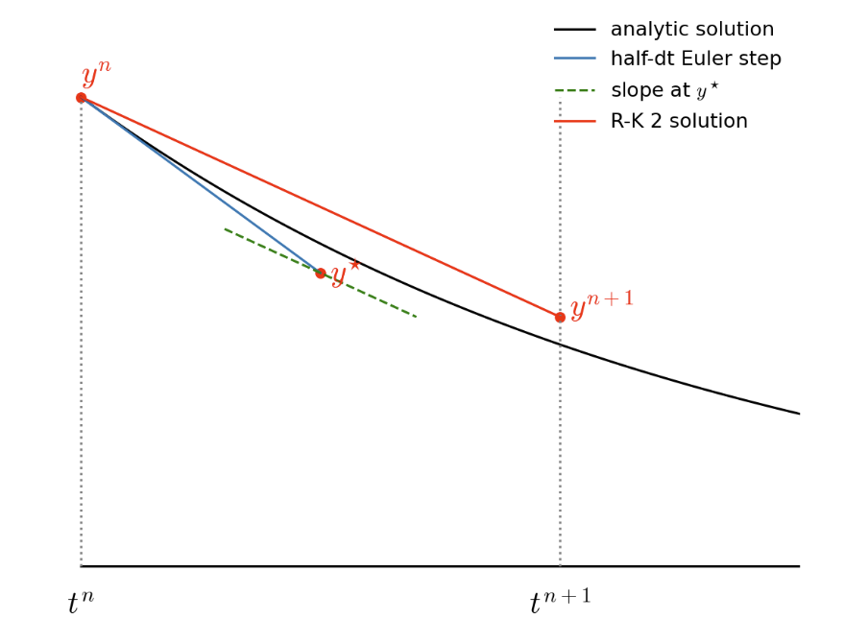
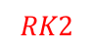
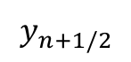
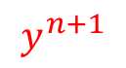
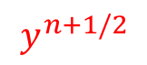
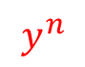
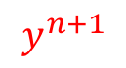
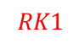
2’st order Runge-Kutta
$$y^{n}$$
$$y_{n+1/2}$$
$$y^{n+1/2}$$
$$y^{n+1}$$
$$RK2$$
$$y^{n+1}$$
$$RK1$$

Slide 12
from math import sin from numpy import arange from pylab import plot, xlabel, ylabel , show
def f(y,t):
return -y**3 + np.sin(t)
a = 0.0 # Start of the interval
b = 10.0 # End of the interval
N = 1000 # Number of steps
h = (b-a)/N # Size of a single step
y = 0.0 # Initial condition
tpoints = np.arange(a,b,h)
ypoints = []
for t in tpoints:
ypoints.append(y)
k1 =h*f(y,t)
k2 =h*f(y+0.5*k1,t+0.5*h)
y += k2
y(t)

Slide 13
4’st order Runge-Kutta
Improve accuracy by preforming Taylor expansion around additional points in the interval and take the correct linear combination.
Equation becomes more complicated and requires additional computational steps.
Sweet spot at the 4’th order RK.

Slide 14
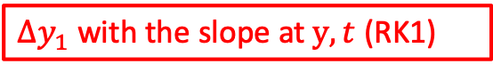
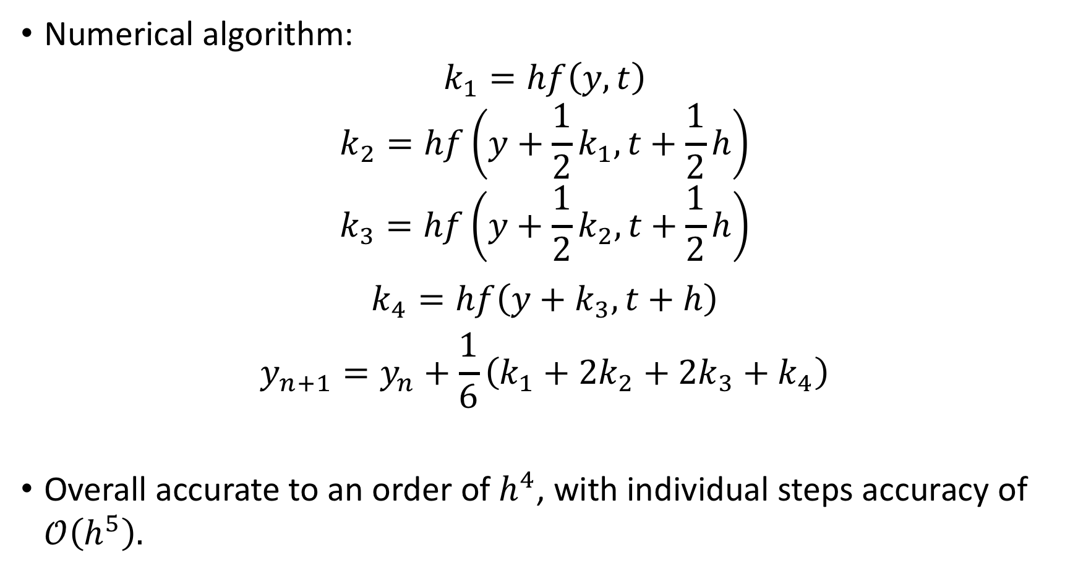
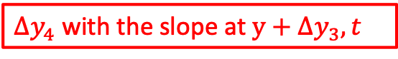
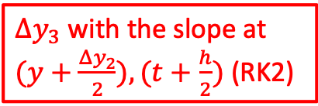
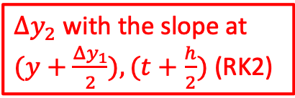
4’st order Runge-Kutta
Numerical algorithm:
$$k_{1}=hf\left(y,t\right)$$
$$k_{2}=hf\left(y+\frac{1}{2}k_{1},t+\frac{1}{2}h\right)$$
$$k_{3}=hf\left(y+\frac{1}{2}k_{2},t+\frac{1}{2}h\right)$$
$$k_{4}=hf\left(y+k_{3},t+h\right)$$
$$y_{n+1}=y_{n}+\frac{1}{6}\left({k_{1}+2k}_{2}+2k_{3}+k_{4}\right)$$
Overall accurate to an order of $h^{4}$, with individual steps accuracy of $𝒪\left(h^{5}\right).$
$Δy_{1}$ with the slope at $y,t$ (RK1)
$Δy_{2}$with the slope at
$(y+\frac{Δy_{1}}{2}),(t+\frac{h}{2})$ (RK2)
$Δy_{3}$with the slope at
$(y+\frac{Δy_{2}}{2}),(t+\frac{h}{2})$ (RK2)
$Δy_{4}$ with the slope at $y+Δy_{3},t$

Slide 15
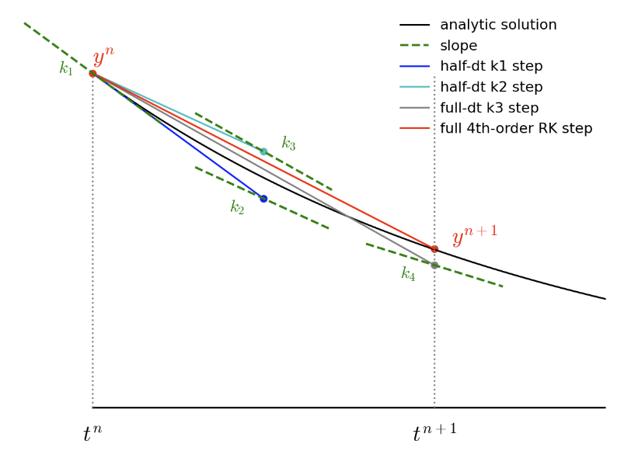
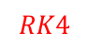
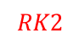
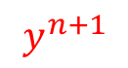
4’st order Runge-Kutta
$$y^{n+1}$$
$$RK2$$
$$y^{n+1}$$
$$RK4$$
$$y^{n+1}$$
$$RK1$$

Slide 16
from math import sin from numpy import arange from pylab import plot, xlabel, ylabel , show
def f(y,t):
return -y**3 + np.sin(t)
a = 0.0 # Start of the interval
b = 10.0 # End of the interval
N = 1000 # Number of steps
h = (b-a)/N # Size of a single step
y = 0.0 # Initial condition
tpoints = np.arange(a,b,h)
ypoints = []
for t in tpoints:
ypoints.append(y)
k1 = h*f(y,t)
k2 = h*f(y+0.5*k1,t+0.5*h)
k3 = h*f(y+0.5*k2,t+0.5*h)
k4 = h*f(y+k3,t+h)
y += (k1+2*k2+2*k3+k4)/6
y(t)

Slide 17
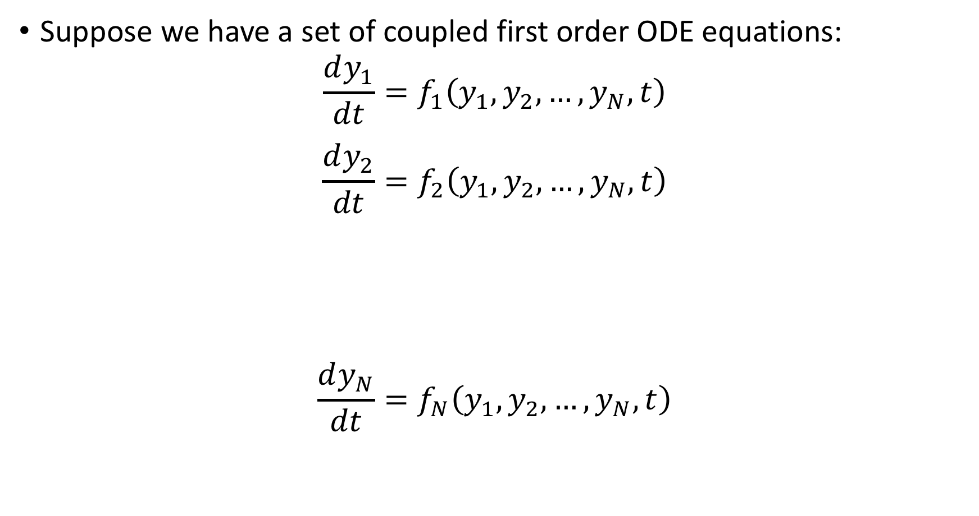
Dealing with coupled systems of ODEs
Suppose we have a set of coupled first order ODE equations:
$$\frac{dy_{1}}{dt}=f_{1}\left(y_{1},y_{2},…,y_{N},t\right)$$
$$\frac{dy_{2}}{dt}=f_{2}\left(y_{1},y_{2},…,y_{N},t\right)$$
$$\frac{dy_{N}}{dt}=f_{N}\left(y_{1},y_{2},…,y_{N},t\right)$$
…
…

Slide 18
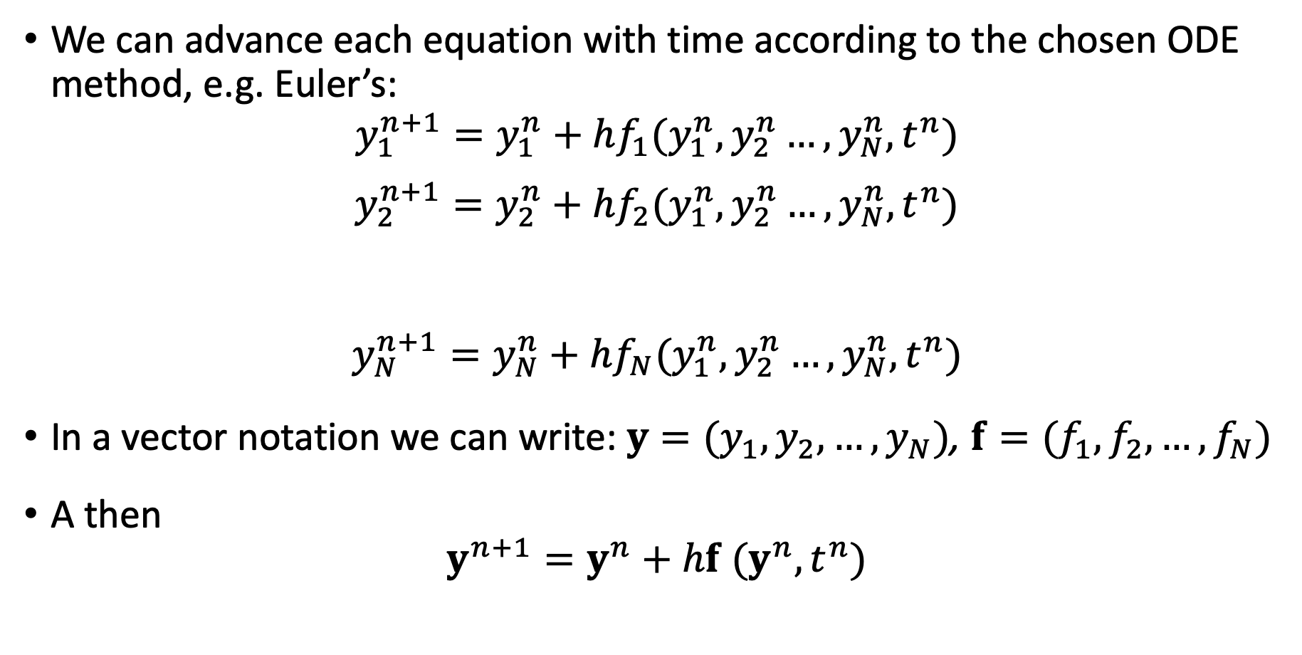
Dealing with coupled systems of ODEs
We can advance each equation with time according to the chosen ODE method, e.g. Euler’s:
$$y_{1}^{n+1}=y_{1}^{n}+hf_{1}(y_{1}^{n},y_{2}^{n}…,y_{N}^{n},t^{n})$$
$$y_{2}^{n+1}=y_{2}^{n}+hf_{2}(y_{1}^{n},y_{2}^{n}…,y_{N}^{n},t^{n})$$
$$y_{N}^{n+1}=y_{N}^{n}+hf_{N}(y_{1}^{n},y_{2}^{n}…,y_{N}^{n},t^{n})$$
In a vector notation we can write: $y=(y_{1},y_{2},…,y_{N})$, $f=(f_{1},f_{2},…,f_{N})$
A then
$$y^{n+1}=y^{n}+hf (y^{n},t^{n})$$
…
…

Slide 19
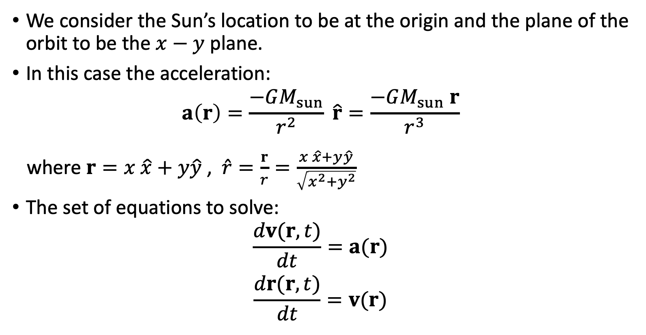
Example: A body orbiting the sun
We consider the Sun’s location to be at the origin and the plane of the orbit to be the $x−y$ plane.
In this case the acceleration:
$$a\left(r\right)=\frac{−GM_{sun}}{r^{2}} \hat{r}=\frac{−GM_{sun} r}{r^{3}}$$
where $r=x \hat{x}+y\hat{y}$ , $\hat{r}=\frac{r}{r}=\frac{x \hat{x}+y\hat{y}}{\sqrt{x^{2}+y^{2}}}$
The set of equations to solve:
$$\frac{dv(r,t)}{dt}=a(r)$$
$$\frac{dr(r,t)}{dt}=v(r)$$

Slide 20
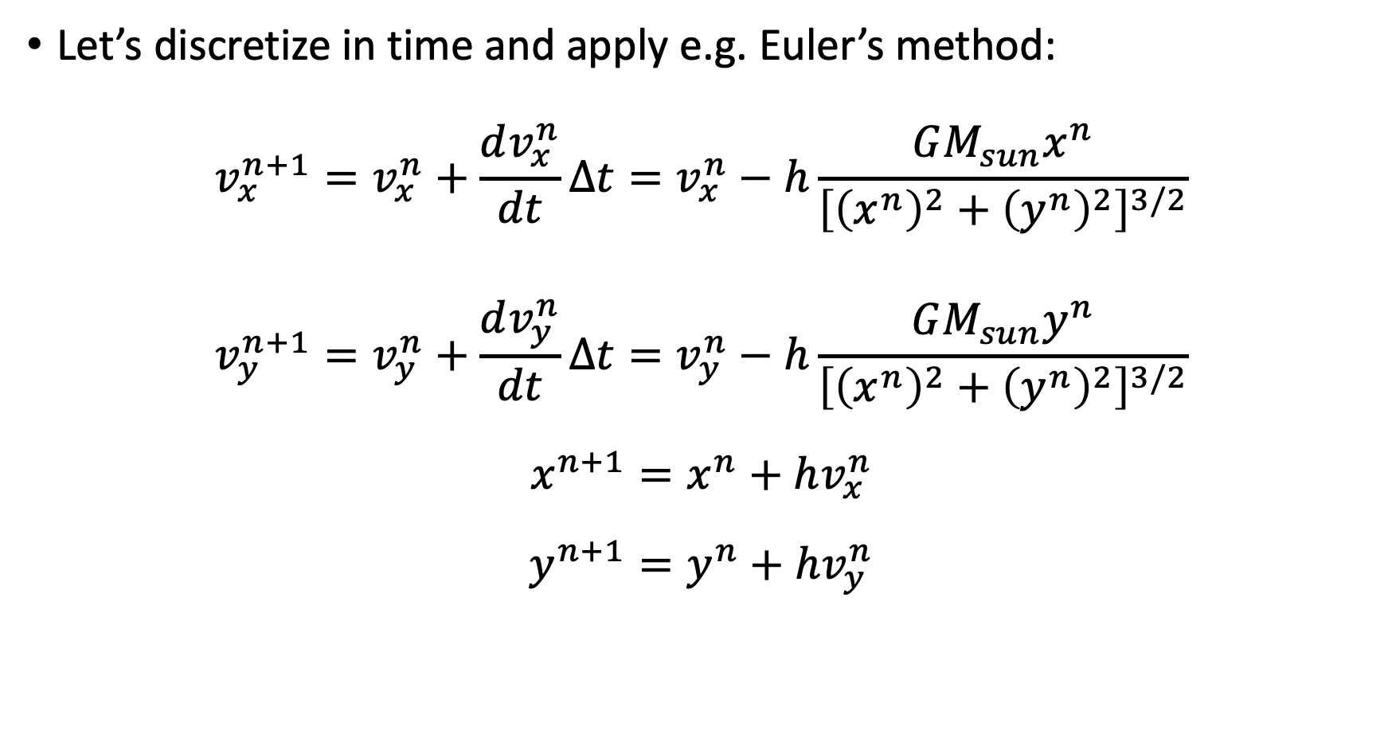
Example: A body orbiting the sun
Let’s discretize in time and apply e.g. Euler’s method:
$$v_{x}^{n+1}=v_{x}^{n}+\frac{dv_{x}^{n}}{dt}Δt=v_{x}^{n}−h\frac{GM_{sun}x^{n}}{{\left[{\left(x^{n}\right)}^{2}+{\left(y^{n}\right)}^{2}\right]}^{3/2}}$$
$$v_{y}^{n+1}=v_{y}^{n}+\frac{dv_{y}^{n}}{dt}Δt=v_{y}^{n}−h\frac{GM_{sun}y^{n}}{{\left[{\left(x^{n}\right)}^{2}+{\left(y^{n}\right)}^{2}\right]}^{3/2}}$$
$$x^{n+1}=x^{n}+hv_{x}^{n}$$
$$y^{n+1}=y^{n}+hv_{y}^{n}$$

Slide 21
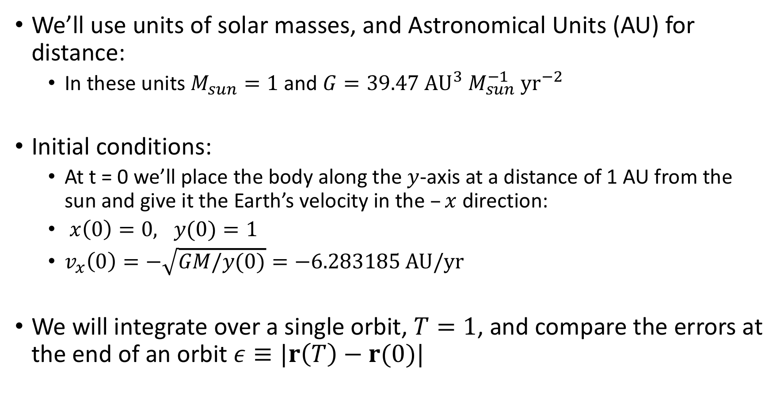
Example: A body orbiting the sun
We’ll use units of solar masses, and Astronomical Units (AU) for distance:
In these units $M_{sun}=1$ and $G=39.47 AU^{3}{ M}_{sun}^{−1} yr^{−2}$
Initial conditions:
At t = 0 we’ll place the body along the $y$-axis at a distance of 1 AU from the sun and give it the Earth’s velocity in the $–x$ direction:
$x\left(0\right)=0, y(0)=1$
$v_{x}\left(0\right)=−\sqrt{GM/y(0)}=−6.283185 AU/yr$
We will integrate over a single orbit, $T=1$, and compare the errors at the end of an orbit $ε≡|r\left(T\right)−r(0)|$

Slide 22
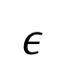
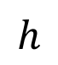
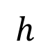
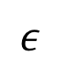
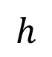
Euler
RK-2
RK-4
$$h$$
$$ε$$
$$h$$
$$ε$$
$$h$$
$$ε$$
0.100000 : 4.186923
0.050000 : 2.631326
0.025000 : 1.579519
0.012500 : 0.878813
0.006250 : 0.458916
0.100000 : 0.011600
0.050000 : 0.011123
0.025000 : 0.002471
0.012500 : 0.000361
0.006250 : 0.000047
0.100000 : 0.020244
0.050000 : 0.000547
0.025000 : 0.000017
0.012500 : 0.000001
0.006250 : 0.000000
Source: M.Z. course AST390

Slide 23
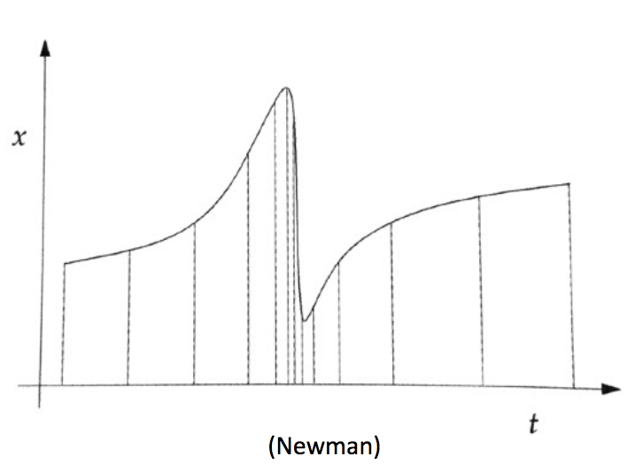
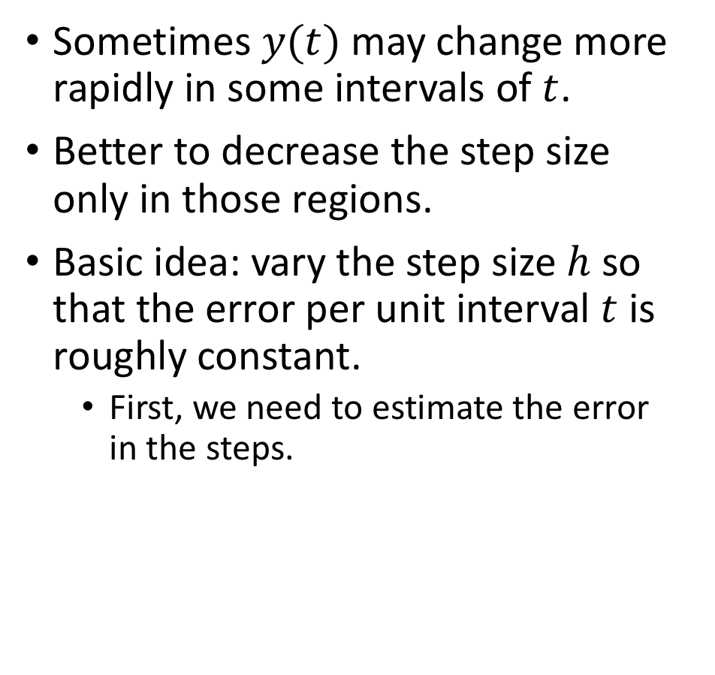
Adaptive step size Runge-Kutta method
Sometimes $y(t)$ may change more rapidly in some intervals of $t$.
Better to decrease the step size only in those regions.
Basic idea: vary the step size $h$ so that the error per unit interval $t$ is roughly constant.
First, we need to estimate the error in the steps.

Slide 24
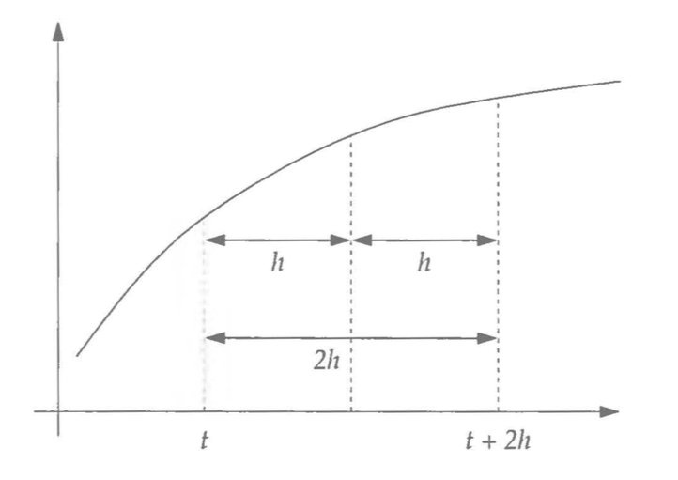
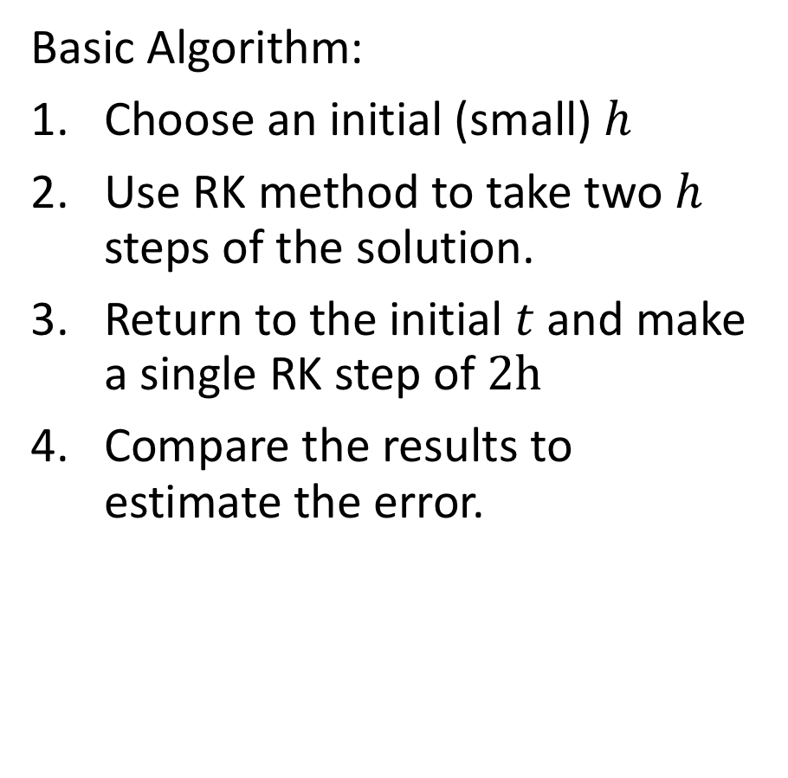
Adaptive step size: Estimating the error
Basic Algorithm:
Choose an initial (small) $h$
Use RK method to take two $h$ steps of the solution.
Return to the initial $t$ and make a single RK step of $2h$
Compare the results to estimate the error.

Slide 25
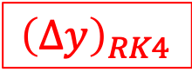
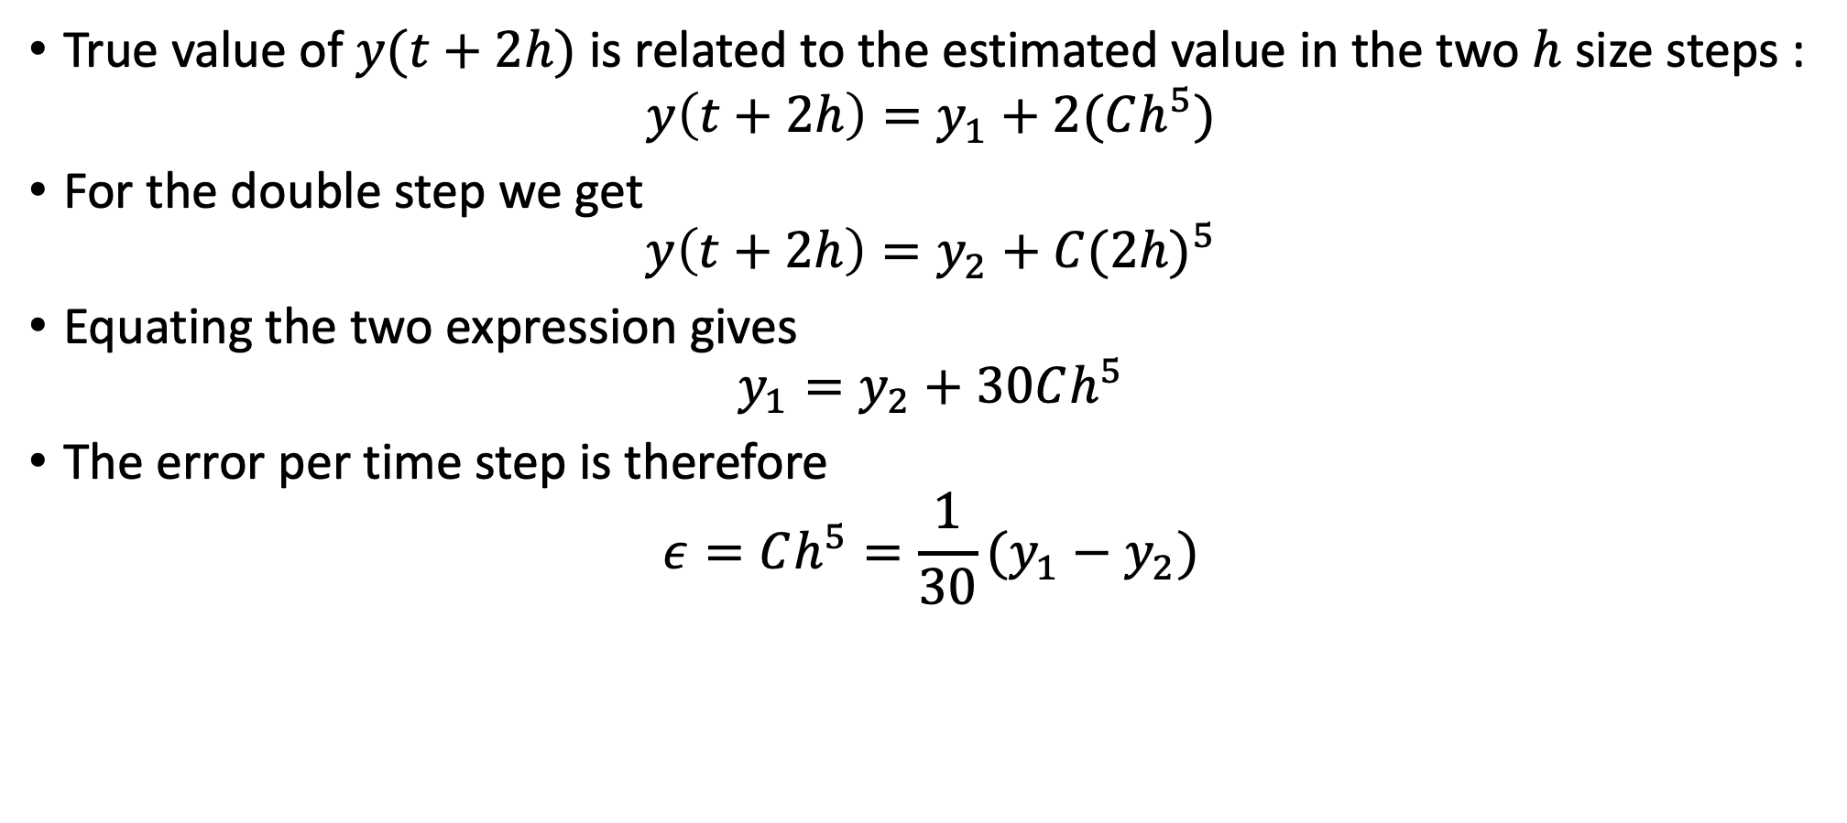
Adaptive step size: Estimating the error
True value of $y(t+2h)$ is related to the estimated value in the two $h$ size steps :
$$y\left(t+2h\right)=y_{1}+2(Ch^{5})$$
For the double step we get
$$y\left(t+2h\right)=y_{2}+C{(2h)}^{5}$$
Equating the two expression gives
$$y_{1}=y_{2}+30Ch^{5}$$
The error per time step is therefore
$$ε=Ch^{5}=\frac{1}{30}(y_{1}−y_{2})$$
$${\left(Δy\right)}_{RK4}$$

Slide 26
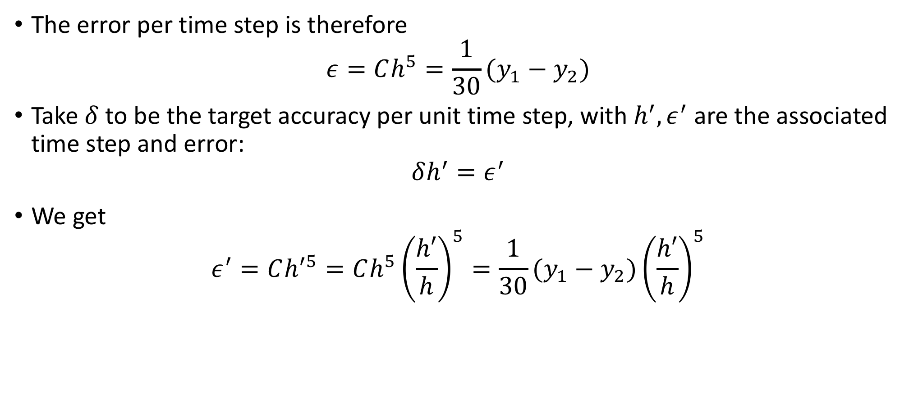
Adaptive step size: Estimating the error
The error per time step is therefore
$$ε=Ch^{5}=\frac{1}{30}(y_{1}−y_{2})$$
Take$δ$to be the target accuracy per unit time step, with $h^{′}, ε^{′}$ are the associated time step and error:
$$δh^{′}=ε^{′}$$
We get
$$ε^{′}=Ch^{′5}=Ch^{5}{\left(\frac{h′}{h}\right)}^{5}=\frac{1}{30}(y_{1}−y_{2}){\left(\frac{h′}{h}\right)}^{5}$$

Slide 27
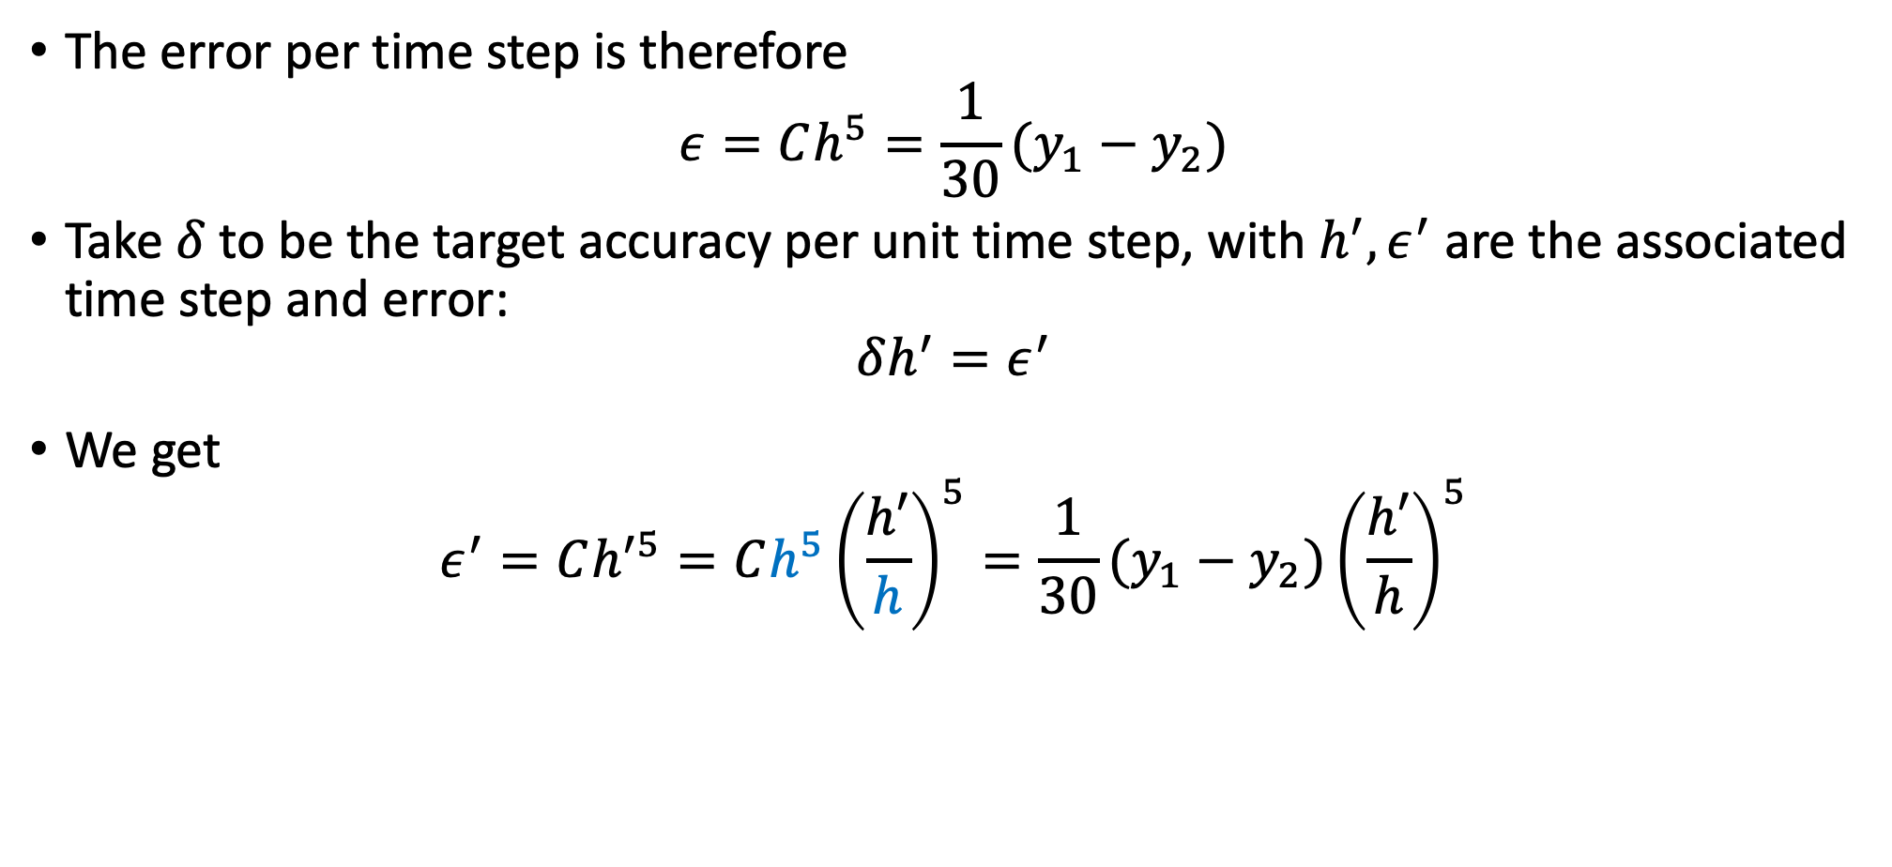
Adaptive step size: Estimating the error
The error per time step is therefore
$$ε=Ch^{5}=\frac{1}{30}(y_{1}−y_{2})$$
Take$δ$to be the target accuracy per unit time step, with $h^{′}, ε^{′}$ are the associated time step and error:
$$δh^{′}=ε^{′}$$
We get
$$ε^{′}=Ch^{′5}=Ch^{5}{\left(\frac{h′}{h}\right)}^{5}=\frac{1}{30}(y_{1}−y_{2}){\left(\frac{h′}{h}\right)}^{5}$$

Slide 28
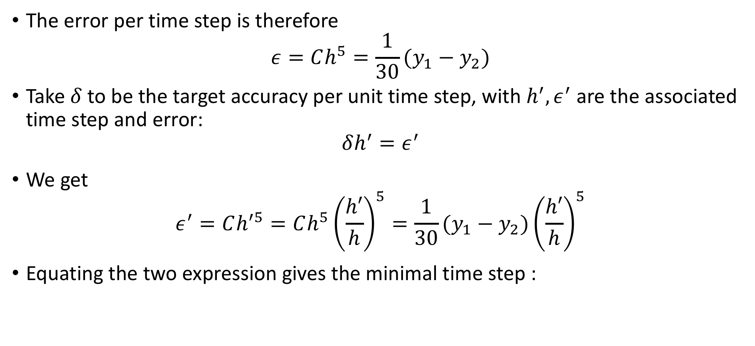
Adaptive step size: Estimating the error
The error per time step is therefore
$$ε=Ch^{5}=\frac{1}{30}(y_{1}−y_{2})$$
Take$δ$to be the target accuracy per unit time step, with $h^{′}, ε^{′}$ are the associated time step and error:
$$δh^{′}=ε^{′}$$
We get
$$ε^{′}=Ch^{′5}=Ch^{5}{\left(\frac{h′}{h}\right)}^{5}=\frac{1}{30}(y_{1}−y_{2}){\left(\frac{h′}{h}\right)}^{5}$$
Equating the two expression gives the minimal time step :

Slide 29
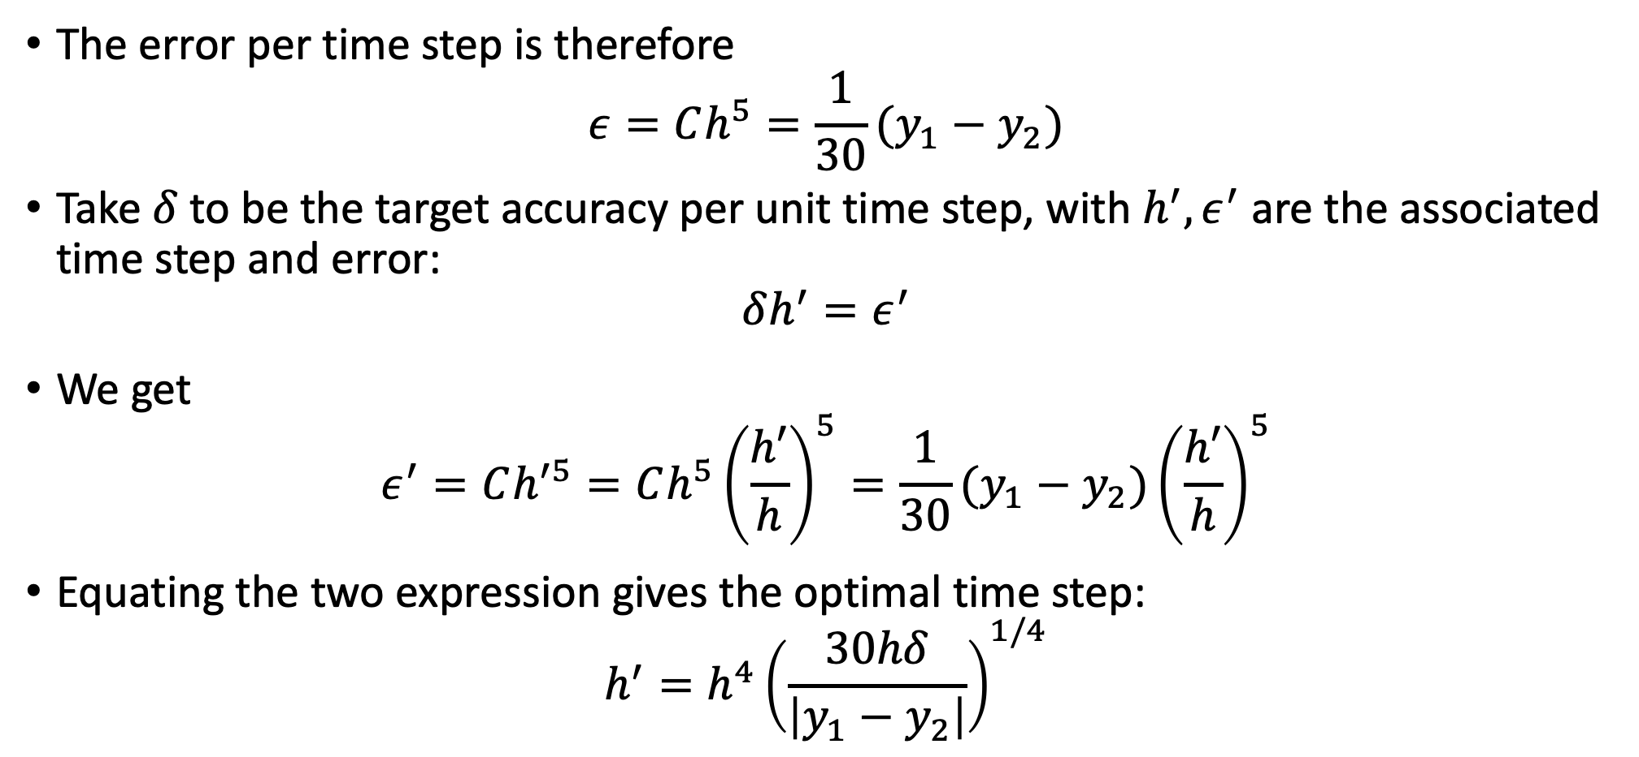
Adaptive step size: Estimating the error
The error per time step is therefore
$$ε=Ch^{5}=\frac{1}{30}(y_{1}−y_{2})$$
Take$δ$to be the target accuracy per unit time step, with $h^{′}, ε^{′}$ are the associated time step and error:
$$δh^{′}=ε^{′}$$
We get
$$ε^{′}=Ch^{′5}=Ch^{5}{\left(\frac{h′}{h}\right)}^{5}=\frac{1}{30}(y_{1}−y_{2}){\left(\frac{h′}{h}\right)}^{5}$$
Equating the two expression gives the optimal time step:
$$h^{′}=h^{4}{\left(\frac{30hδ}{\left|y_{1}−y_{2}\right|}\right)}^{1/4}$$

Slide 30
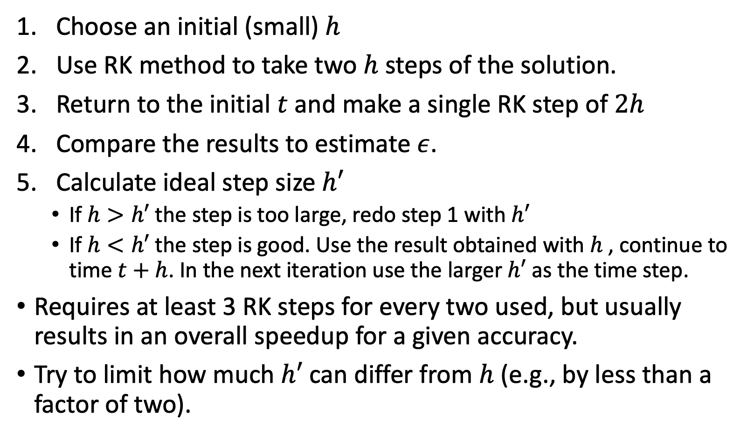
Adaptive step size: Complete approach
Choose an initial (small) $h$
Use RK method to take two $h$ steps of the solution.
Return to the initial $t$ and make a single RK step of $2h$
Compare the results to estimate $ε$.
Calculate ideal step size $h′$
If $h>h′$ the step is too large, redo step 1 with $h′$
If $h<h′$ the step is good. Use the result obtained with $h$, continue to time $t+h$. In the next iteration use the larger $h′$ as the time step.
Requires at least 3 RK steps for every two used, but usually results in an overall speedup for a given accuracy.
Try to limit how much $h′$ can differ from $h$ (e.g., by less than a factor of two).

Slide 31
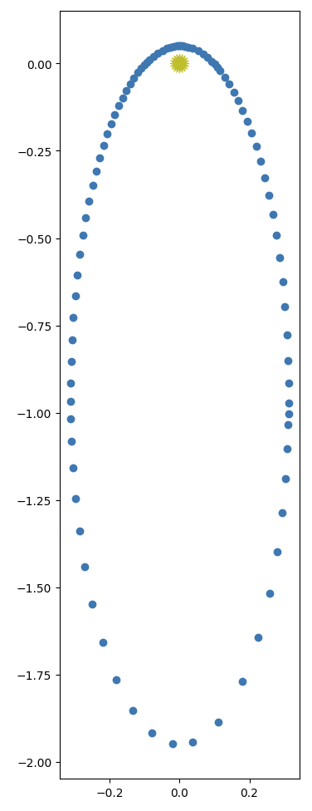



Adaptive step size: Example
Left: Eccentric orbit with an adaptive time step and error tolerance of ${10}^{−5}$.
Number of steps: 95
From: Zingale computational_astrophysics
Right: Eccentric orbit with a constant time step of $h/T_{orb}$=0.001.
Number of steps: 1001

Slide 32

Beyond RK : Leapfrog method.
2’nd order RK:
E$stimate y(t+h)$ using the slope at midpoint $f\left(t+\frac{h}{2}, y(t+\frac{h}{2})\right)$.
Use Euler method to estimate $y$ at midpoint (half step)
$$y\left(t+\frac{h}{2}\right)=y\left(t\right)+\frac{1}{2}hf(t,y)$$
Use Euler method with the slope at midpoint to estimate $y(t+h)$ (full step)
$$y\left(t+h\right)=y\left(t\right)+hf\left(t+\frac{h}{2}, y(t+\frac{h}{2})\right)$$
Leapfrog method uses a similar approach, except it calculates the next midpoint by using the Euler method evaluated at the previous midpoint.

Slide 33

Leapfrog method versus 2’nd order RK
2’nd order RK:
Leapfrog:
Newman (Ch 8.5)

Slide 34





Leapfrog method
Start the same as RK:
$$y\left(t+\frac{h}{2}\right)=y\left(t\right)+\frac{1}{2}hf(t,y)$$
$$y\left(t+h\right)=y\left(t\right)+hf\left(t+\frac{h}{2}, y(t+\frac{h}{2})\right)$$
For the next step:
$$y\left(t+\frac{3h}{2}\right)=y\left(t+\frac{h}{2}\right)+hf(t+h,y(t+h))$$
$$y\left(t+2h\right)=y\left(t+h\right)+hf\left(t+\frac{3h}{2}, y(t+\frac{3h}{2})\right)$$
$$t+\frac{h}{2}$$
$$t+\frac{3h}{2}$$
$$t$$
$$t+h$$

Slide 35



Leapfrog method
Start the same as RK:
$$y\left(t+\frac{h}{2}\right)=y\left(t\right)+\frac{1}{2}hf(t,y)$$
$$y\left(t+h\right)=y\left(t\right)+hf\left(t+\frac{h}{2}, y(t+\frac{h}{2})\right)$$
For the next step:
$$y\left(t+\frac{3h}{2}\right)=y\left(t+\frac{h}{2}\right)+hf(t+h,y(t+h))$$
$$y\left(t+2h\right)=y\left(t+h\right)+hf\left(t+\frac{3h}{2}, y(t+\frac{3h}{2})\right)$$
$$t+\frac{h}{2}$$
$$t+\frac{3h}{2}$$
$$t$$
$$t+h$$
$$t+\frac{h}{2}$$
$$t+\frac{3h}{2}$$
$$t$$
$$t+h$$

Slide 36

Leapfrog method
Start the same as RK:
$$y\left(t+\frac{h}{2}\right)=y\left(t\right)+\frac{1}{2}hf(t,y)$$
$$y\left(t+h\right)=y\left(t\right)+hf\left(t+\frac{h}{2}, y(t+\frac{h}{2})\right)$$
For the next step:
$$y\left(t+\frac{3h}{2}\right)=y\left(t+\frac{h}{2}\right)+hf(t+h,y(t+h))$$
$$y\left(t+2h\right)=y\left(t+h\right)+hf\left(t+\frac{3h}{2}, y(t+\frac{3h}{2})\right)$$
$$t+\frac{h}{2}$$
$$t+\frac{3h}{2}$$
$$t$$
$$t+h$$
$$t+\frac{h}{2}$$
$$t+\frac{3h}{2}$$
$$t$$
$$t+h$$

Slide 37

Why the leapfrog method?
Errors are similar to 2’nd order RK:
Overall accurate to an order of $h^{2}$, with individual steps accuracy of $𝒪\left(h^{3}\right).$
But 4’th order RK is more accurate.
What is the advantage in using it?
The solution is time reversal symmetric.
Useful for physics problems where energy conservation is important

Slide 38









What is time reversal symmetry?
When using $−h$instead of $h$ we should retrace our steps.
To see this, start with the equations we apply for the Leapfrog method:
$$y\left(t+h\right)=y\left(t\right)+hf\left(t+\frac{h}{2}, y(t+\frac{h}{2})\right)$$
$$y\left(t+\frac{3h}{2}\right)=y\left(t+\frac{h}{2}\right)+hf(t+h,y(t+h))$$
Set step size to $−h$
$$y\left(t−h\right)=y\left(t\right)−hf\left(t−\frac{h}{2}, y(t−\frac{h}{2})\right)$$
$$y\left(t−\frac{3h}{2}\right)=y\left(t−\frac{h}{2}\right)−hf(t−h,y(t−h))$$
$$t+\frac{h}{2}$$
$$t+\frac{3h}{2}$$
$$t$$
$$t+h$$
$$t−\frac{3h}{2}$$
$$t−\frac{h}{2}$$
$$t$$
$$t−h$$

Slide 39
What is time reversal symmetry?
When using $−h$instead of $h$ we should retrace our steps.
To see this, start with the equations we apply for the Leapfrog method:
$$y\left(t+h\right)=y\left(t\right)+hf\left(t+\frac{h}{2}, y(t+\frac{h}{2})\right)$$
$$y\left(t+\frac{3h}{2}\right)=y\left(t+\frac{h}{2}\right)+hf(t+h,y(t+h))$$
Set step size to $−h$
$$y\left(t−h\right)=y\left(t\right)−hf\left(t−\frac{h}{2}, y(t−\frac{h}{2})\right)$$
$$y\left(t−\frac{3h}{2}\right)=y\left(t−\frac{h}{2}\right)−hf(t−h,y(t−h))$$
$$t+\frac{h}{2}$$
$$t+\frac{3h}{2}$$
$$t$$
$$t+h$$
$$t−\frac{3h}{2}$$
$$t−\frac{h}{2}$$
$$t$$
$$t−h$$

Slide 40





What is time reversal symmetry?
When using $−h$instead of $h$ we should retrace our steps.
To see this, start with the equations we apply for the Leapfrog method:
$$y\left(t+h\right)=y\left(t\right)+hf\left(t+\frac{h}{2}, y(t+\frac{h}{2})\right)$$
$$y\left(t+\frac{3h}{2}\right)=y\left(t+\frac{h}{2}\right)+hf(t+h,y(t+h))$$
Now make the trivial shift $t→t+3t/2$
$$y\left(t−h\right)=y\left(t\right)−hf\left(t−\frac{h}{2}, y(t−\frac{h}{2})\right)$$
$$y\left(t−\frac{3h}{2}\right)=y\left(t−\frac{h}{2}\right)−hf(t−h,y(t−h))$$
$$t+\frac{h}{2}$$
$$t+\frac{3h}{2}$$
$$t$$
$$t+h$$
$$t+\frac{h}{2}$$
$$t+\frac{3h}{2}$$
$$t$$
$$t+h$$
$$t−\frac{3h}{2}$$
$$t−\frac{h}{2}$$
$$t$$
$$t−h$$

Slide 41



What is time reversal symmetry?
When using $−h$instead of $h$ we should retrace our steps.
To see this, start with the equations we apply for the Leapfrog method:
$$y\left(t+h\right)=y\left(t\right)+hf\left(t+\frac{h}{2}, y(t+\frac{h}{2})\right)$$
$$y\left(t+\frac{3h}{2}\right)=y\left(t+\frac{h}{2}\right)+hf(t+h,y(t+h))$$
Now make the trivial shift $t→t+3t/2$
$$y\left(t+\frac{h}{2}\right)=y\left(t+\frac{3h}{2}\right)−hf\left(t+h, y(t+h)\right)$$
$$y\left(t\right)=y\left(t+h\right)−hf(t+\frac{h}{2},y(t+\frac{h}{2}))$$
$$t+\frac{h}{2}$$
$$t+\frac{3h}{2}$$
$$t$$
$$t+h$$
$$t+\frac{h}{2}$$
$$t+\frac{3h}{2}$$
$$t$$
$$t+h$$

Slide 42

What is time reversal symmetry?
When using $−h$instead of $h$ we should retrace our steps.
To see this, start with the equations we apply for the Leapfrog method:
$$y\left(t+h\right)=y\left(t\right)+hf\left(t+\frac{h}{2}, y(t+\frac{h}{2})\right)$$
$$y\left(t+\frac{3h}{2}\right)=y\left(t+\frac{h}{2}\right)+hf(t+h,y(t+h))$$
Now make the trivial shift $t→t+3h/2$
$$y\left(t+\frac{h}{2}\right)=y\left(t+\frac{3h}{2}\right)−hf\left(t+h, y(t+h)\right)$$
$$y\left(t\right)=y\left(t+h\right)−hf(t+\frac{h}{2},y(t+\frac{h}{2}))$$
$$t+\frac{h}{2}$$
$$t+\frac{3h}{2}$$
$$t$$
$$t+h$$
$$t+\frac{h}{2}$$
$$t+\frac{3h}{2}$$
$$t$$
$$t+h$$

Slide 43

Time reverse in 2’nd order Runge-Kutta
Original expression: $y\left(t+\frac{h}{2}\right)=y\left(t\right)+\frac{1}{2}hf(t,y)$
$y\left(t+h\right)=y\left(t\right)+hf\left(t+\frac{h}{2}, y(t+\frac{h}{2})\right)$
Set step size to $−h$: $y\left(t−\frac{h}{2}\right)=y\left(t\right)−\frac{1}{2}hf(t,y)$
$y\left(t−h\right)=y\left(t\right)−hf\left(t−\frac{h}{2}, y(t−\frac{h}{2})\right)$
There is no shift $t→t+ah$that we can do to both equations of the backward step to make them mathematically equal to the forward step.

Slide 44
Time reverse in 2’nd order Runge-Kutta
Original expression: $y\left(t+\frac{h}{2}\right)=y\left(t\right)+\frac{1}{2}hf(t,y)$
$y\left(t+h\right)=y\left(t\right)+hf\left(t+\frac{h}{2}, y(t+\frac{h}{2})\right)$
Set step size to $−h$: $y\left(t−\frac{h}{2}\right)=y\left(t\right)−\frac{1}{2}hf(t,y)$
$y\left(t−h\right)=y\left(t\right)−hf\left(t−\frac{h}{2}, y(t−\frac{h}{2})\right)$
There is no shift $t→t+ah$that we can do to both equations of the backward step to make them mathematically equal to the forward step.
Errors will result in broken time-reversal symmetry

Slide 45

Energy conservation, Leapfrog vs 2’nd RK
Potential energy
Kinetic energy
Potential energy
Kinetic energy

Slide 46

The leapfrog/Verlet method for equations of motion
For this method we will limit ourselves to ODEs of the form of equations of motion:
$$\frac{dy}{dt}=v\left(t\right), \frac{dv}{dt}=f(t,y)$$
The R.H.S for the first eq. doesn’t depend on $y$ and the R.H.S of the second eq. doesn’t depend on $v$.
We can do the leapfrog method with two equations:
$$y\left(t+h\right)=y\left(t\right)+hv\left(t+\frac{h}{2}\right)$$
$$v\left(t+\frac{3h}{2}\right)=v\left(t+\frac{h}{2}\right)+hf\left(t+h,y(t+h)\right)$$
position only at integer steps
position only at half-integer steps

Slide 47

Calculating the total energy at a point.
The total energy requires knowing $y$ and $v$ at the same point
Let’s just step the velocity back half a step with Euler’s method:
$$v\left(t+\frac{h}{2}\right)=v\left(t+h\right)−\frac{1}{2}hf\left(t+h,y\left(t+h\right)\right)$$
Rearrange to get:
$$v\left(t+h\right)=v\left(t+\frac{h}{2}\right)+\frac{1}{2}hf\left(t+h,y\left(t+h\right)\right)$$
Gives velocity at integer points from quantities we have already calculated.

Slide 48

Leapfrog/Verlet complete coevolution
First do an initial half step:
$$v\left(t+\frac{h}{2}\right)=v\left(t\right)+\frac{1}{2}hf(t,y\left(t\right))$$
Then repeatedly apply:
$$y\left(t+h\right)=y\left(t\right)+hv\left(t+\frac{h}{2}\right)$$
$$k=hf\left(t+h,y\left(t+h\right)\right)$$
$$v\left(t+h\right)=v\left(t+\frac{h}{2}\right)+\frac{1}{2}k$$
$$v\left(t+\frac{3h}{2}\right)=v\left(t+\frac{h}{2}\right)+k$$
velocity at integer point
for energy evaluation
velocity at half point
for the next time step

Slide 49

The errors in the leapfrog method
Error of a single step is proportional to Δ$t^{3}$ to a leading order
What about the other orders? Time reversal symmetry gives:
$$ε\left(−Δt\right)=−ε(Δt)$$
This means that the error must be a combination of odd powers:
$ε\left(Δt\right)=c_{3}Δt^{3}+c_{5}Δt^{5}+c_{7}Δt^{7}+$…
The maximal total error is the sum of all individual errors:
$$ε_{tot}\left(Δt\right)=ε\left(Δt\right)×\frac{t_{f}−t_{0}}{Δt}$$
which is an order less accurate in $Δt$ than individual steps:
$ε_{tot}\left(Δt\right)=b_{2}Δt^{2}+b_{4}Δt^{4}+b_{6}Δt^{6}+$…

Slide 50

Wait, what about initial Euler half step?
Remember that for the initial step we use half step with Euler method
$$y\left(t+\frac{1}{2}Δt\right)=y\left(t\right)+\frac{1}{2}Δtf(y\left(t\right),t)$$
Leading order accuracy of Euler method is $Δt^{2}$, doesn’t reduce overall accuracy.
However the higher order terms of the Euler half step are both even and odd, destroying the time reversibility.

Slide 51










Removing errors from initial Euler half step
$y_{0}^{int}=y\left(t\right)$
$y_{1}^{half}=y_{0}^{int}+\frac{1}{2}Δtf(y_{0}^{int},t)$
Define the variable at integer and half steps:
Then:
$$y_{1}^{int}=y_{0}^{int}+Δtf(y_{1}^{half},t+1/2Δt)$$
$$y_{2}^{half}=y_{1}^{half}+Δtf(y_{1}^{int},t+Δt)$$
$$y_{2}^{int}=y_{1}^{int}+Δtf(y_{2}^{half},t+3/2Δt)$$
$$y_{m+1}^{half}=y_{m}^{half}+Δtf(y_{m}^{int},t+mΔt)$$
$$y_{m+1}^{int}=y_{m}^{int}+Δtf(y_{m+1}^{half},t+\left(m+1/2\right)Δt)$$
…
…
$$y_{0}^{int}$$
$$y_{1}^{int}$$
$$y_{2}^{int}$$
$$y_{n}^{int}$$
$$y_{1}^{half}$$
$$y_{2}^{half}$$
$$y_{3}^{half}$$
$$y_{n}^{half}$$

Slide 52

Removing errors from initial Euler half step: Modified midpoint method
Take $t_{f}$ as the final time of the calculation, achieved at step $n$
We can write the final solution for $y(t+H)$in two ways:
$$y\left(t+H\right)=y_{n}^{int}=y_{n}^{half}+\frac{1}{2}Δtf(y_{n}^{int},t+H)$$
Or we can use the average of the two:
$$y\left(t+H\right)=\frac{1}{2}\left[y_{n}^{int}+y_{n}^{half}+\frac{1}{2}Δtf(y_{n}^{int},t+H) \right]$$
This cancels the error from the initial Euler step!
Proved by mathematician William Gragg in 1965
$$y_{0}^{int}$$
$$y_{1}^{int}$$
$$y_{2}^{int}$$
$$y_{n}^{int}$$
$$y_{1}^{half}$$
$$y_{2}^{half}$$
$$y_{3}^{half}$$
$$y_{n}^{half}$$

Slide 53


Modified midpoint method
$$y\left(t+H\right)=\frac{1}{2}\left[y_{n}^{int}+y_{n}^{half}+\frac{1}{2}Δtf(y_{n}^{int},t+H) \right]$$
This cancels the error from the initial Euler step!
Proved by mathematician William Gragg in 1965
Modified midpoint method: Using the iterative steps from the
previous slide and the above expression for $y(t+H)$
The result is symmetric in time.
$$y_{0}^{int}$$
$$y_{1}^{int}$$
$$y_{2}^{int}$$
$$y_{n}^{int}$$
$$y_{1}^{half}$$
$$y_{2}^{half}$$
$$y_{3}^{half}$$
$$y_{n}^{half}$$

Slide 54
THE BULIRSCH-STOER METHOD
The modified midpoint offers little advantage over either the ordinary leapfrog method (if you want an energy conserving solution) or the fourth-order Runge-Kutta method (which is significantly more accurate).
It plays an important role, nonetheless, as the basis for the powerful Bulirsch-Stoer method, which achieve high order accuracy with a few relatively large steps.

Slide 55


Simple example of Bulirsch-Stoer: First order ODE with one variable
Let’s solve the equation
$$\frac{dx}{dt}=f(x,t)$$
We would like to solve from $t$to $t_{f}=t+H$, with $x(t)$ given
Start by using the modified midpoint method with a single step $Δt_{1}=H$
More specifically, two half steps $:$
Call this estimate $R_{1,1}$
Now perform the calculation for $Δt_{2}=1/2H$ to get $R_{2,1}$
$y_{0}^{int}=y\left(t\right)$
$y_{1}^{half}=y_{0}+\frac{1}{2}Δt_{1}f(y_{0},t)$
$y_{1}^{int}=y_{0}^{int}+Δt_{1}f\left(y_{1}^{half},t+{Δt_{1}}/2\right)$
$$R_{1,1}=\frac{1}{2}\left[y_{1}^{int}+y_{1}^{half}+\frac{1}{2}Δt_{1}f\left(y_{1}^{int},t+Δt_{1}\right)\right]$$

Slide 56


Performing Richardson extrapolation
We can write the “exact” expressions since we know the form of the errors (using $Δt_{1}=2Δt_{2}$)
$y\left(t+H\right)=R_{2,1}+c_{1}Δt_{2}^{2}+𝒪\left(Δt_{2}^{4}\right)$
$y\left(t+H\right)=R_{1,1}+c_{1}Δt_{1}^{2}+𝒪\left(Δt_{1}^{4}\right)=R_{1,1}+{4c}_{1}Δt_{2}^{2}+𝒪\left(Δt_{2}^{4}\right)$
So:
$$c_{1}Δt_{2}^{2}=\frac{1}{3}\left(R_{2,1}−R_{1,1}\right)$$
And:
$$y\left(t+H\right)=R_{2,1}+\frac{1}{3}\left(R_{2,1}−R_{1,1}\right)+𝒪\left(Δt_{2}^{4}\right)$$
New estimate accurate to fourth order!
$$R_{2,2}$$

Slide 57

Performing Richardson extrapolation
We can write the “exact” expressions since we know the form of the errors (using $Δt_{1}=2Δt_{2}$)
$y\left(t+H\right)=R_{2,1}+c_{1}Δt_{2}^{2}+𝒪\left(Δt_{2}^{4}\right)$
$y\left(t+H\right)=R_{1,1}+c_{1}Δt_{1}^{2}+𝒪\left(Δt_{1}^{4}\right)=R_{1,1}+{4c}_{1}Δt_{2}^{2}+𝒪\left(Δt_{2}^{4}\right)$
Equate the two to get:
$$c_{1}Δt_{2}^{2}=\frac{1}{3}\left(R_{2,1}−R_{1,1}\right)$$
Substitute back:
$$y\left(t+H\right)=R_{2,1}+\frac{1}{3}\left(R_{2,1}−R_{1,1}\right)+𝒪\left(Δt_{2}^{4}\right)$$
New estimate accurate to fourth order!
$$R_{2,2}$$

Slide 58

Performing Richardson extrapolation
We can write the “exact” expressions since we know the form of the errors (using $Δt_{1}=2Δt_{2}$)
$y\left(t+H\right)=R_{2,1}+c_{1}Δt_{2}^{2}+𝒪\left(Δt_{2}^{4}\right)$
$y\left(t+H\right)=R_{1,1}+c_{1}Δt_{1}^{2}+𝒪\left(Δt_{1}^{4}\right)=R_{1,1}+{4c}_{1}Δt_{2}^{2}+𝒪\left(Δt_{2}^{4}\right)$
Equate the two to get:
$$c_{1}Δt_{2}^{2}=\frac{1}{3}\left(R_{2,1}−R_{1,1}\right)$$
Substitute back:
$$y\left(t+H\right)=R_{2,1}+\frac{1}{3}\left(R_{2,1}−R_{1,1}\right)+𝒪\left(Δt_{2}^{4}\right)$$
$$R_{2,2}$$

Slide 59
Performing Richardson extrapolation
We can write the “exact” expressions since we know the form of the errors (using $Δt_{1}=2Δt_{2}$)
$y\left(t+H\right)=R_{2,1}+c_{1}Δt_{2}^{2}+𝒪\left(Δt_{2}^{4}\right)$
$y\left(t+H\right)=R_{1,1}+c_{1}Δt_{1}^{2}+𝒪\left(Δt_{1}^{4}\right)=R_{1,1}+{4c}_{1}Δt_{2}^{2}+𝒪\left(Δt_{2}^{4}\right)$
Equate the two to get:
$$c_{1}Δt_{2}^{2}=\frac{1}{3}\left(R_{2,1}−R_{1,1}\right)$$
Substitute back:
$$y\left(t+H\right)=R_{2,1}+\frac{1}{3}\left(R_{2,1}−R_{1,1}\right)+𝒪\left(Δt_{2}^{4}\right)$$
New estimate accurate to fourth order!
$$R_{2,2}$$

Slide 60

Performing Richardson extrapolation, cont.
Let’s do another step: Calculate $R_{3,1}$ with $Δt_{3}=1/3H$
Following the same steps as before:
$$R_{3,2}=R_{3,1}+\frac{4}{5}\left(R_{3,1}−R_{2,1}\right)$$
Then we can write the “exact” result:
$$y\left(t+H\right)=R_{3,2}+c_{2}Δt_{3}^{4}+𝒪\left(Δt_{3}^{6}\right)$$
From what we had previously and using $Δt_{2}=\frac{3}{2}Δt_{3}$:
$y\left(t+H\right)=R_{2,2}+c_{2}Δt_{2}^{4}+𝒪\left(Δt_{2}^{6}\right)=R_{2,2}+c_{2}{\left(\frac{3}{2}\right)}^{4}Δt_{3}^{4}+𝒪\left(Δt_{3}^{6}\right)$
Equating these gives:
$$c_{2}Δt_{3}^{4}=\frac{16}{65}\left(R_{3,2}−R_{2,2}\right)$$

Slide 61


Performing Richardson extrapolation, cont.
From what we had previously and using $Δt_{2}=\frac{3}{2}Δt_{3}$:
$y\left(t+H\right)=R_{2,2}+c_{2}Δt_{2}^{4}+𝒪\left(Δt_{2}^{6}\right)=R_{3,2}+c_{2}{\left(\frac{3}{2}\right)}^{4}Δt_{3}^{4}+𝒪\left(Δt_{3}^{6}\right)$
Equating these gives:
$$c_{2}Δt_{3}^{4}=\frac{16}{65}\left(R_{3,2}−R_{2,2}\right)$$
So, we have:
$y\left(t+t_{f}\right)=R_{3,2}+\frac{16}{65}\left(R_{3,2}−R_{2,2}\right)+𝒪\left(Δt_{3}^{6}\right)$
Three modified midpoint steps, and already have a sixth-order error!
Gain two orders of accuracy with each step
New estimate accurate to sixth order!
$$R_{3,3}$$

Slide 62


General Richardson extrapolation
n is the number of modified midpoint steps, which gives us $R_{n,1}$
Can go up to obtain $R_{n,m}$ for $m<n$.
$$R_{n,m+1}=R_{n,m}+\frac{R_{n,m}−R_{n−1,m}}{{\left[n/{\left(n−1\right)}\right]}^{2m}−1}$$
See Newman sec. 8.5
Giving an estimate on the result with an error
$y\left(t+H\right)=R_{n,m+1}+𝒪\left(Δt_{n}^{2m+2}\right)$
Newman

Slide 63

Comments about Bulirsch-Stoer
Adaptive method: Provides error and estimate.
Continue until error is below a given accuracy
Similar approach to Romberg integration with some key differences
Increase number of intervals by one in BS instead of doubling in Romberg
Not possible to “reuse” previous points like in Romberg
Only provides accurate estimate for final result $y(t+H)$
At intermediate points, we just get raw midpoint method estimates (accurate to $Δt^{2}$)
Not well suited if we need many (100’s or 1000’s) steps, so only for rather
small regions, where we can get accuracy with < 8 steps
Can divide larger intervals into smaller ones and apply the BS method
Often gives better accuracy with less work then RK, especially for relatively smooth functions
RK should be used for ODEs with pathological behavior, large fluctuations, divergences, etc.

Slide 64

Bulirsch-Stoer Method: Summary
Say we would like to solve an ODE from t to $t_{f}$ up to an accuracy $δ$ per step
First, divide the total range into $N$ equal intervals of length $t_{H}$. Then do the following steps for each interval:
Perform a modified midpoint step with one interval from $t$ to $t_{f}$ to get $R_{1,1}$
Increase the number of intervals by one to $n$ and calculate $R_{n,1}$ with the modified midpoint method
Calculate the “row” via Richardson extrapolation, i.e., $R_{n,2}…R_{n,n}$
Compare the error to the target accuracy $δH$. If it is larger than the target accuracy, return to step 2. If it is less than the target accuracy, go to the next interval.

Slide 65

Example: Orbits with the Bulirsch-Stoer method

Slide 66
Boundary value problems
So far we discussed initial value problem: Solving ODEs given some initial value
Boundary value problems: Conditions needed to specify the solution given at some different (or additional) points to the initial point
E.g.: Find a solution for the EOM such that the trajectory passes through a specific point in the future.
Boundary value problems are more difficult to solve
Two methods: Shooting method and relaxation method (we will discuss the latter in terms of PDEs later)

Slide 67




Shooting method example: Ball thrown in the air
“Trial-and-error” method: Searches for correct values of initial conditions that match a given set of boundary conditions.
Example (from Newman Sec. 8.6): Trajectory of a ball thrown in the air
$$\frac{d^{2}y}{dt^{2}}=−G$$
We know the initial position (but not the velocity) and a time $t_{1}$when the ball lands.
Height $y$
Time $t$
Boundary value

Slide 68

How do we modify the initial conditions?
Guess the initial conditions (initial vertical velocity).
Integrate the ODE to time $t_{1}$ when the ball should land on the ground.
Write the height of the ball at the boundary $t_{1}$as $y\left(t_{1}\right)= f(v_{0})$ where $v_{0}$is the initial velocity.
If we want the ball to be at $y=0$at $t_{1}$, we need to solve $f\left(v_{0}\right)= 0$
So, we have reformulated the problem as finding a root of a function
We can use, e.g., the bisection method, Newton-Raphson method, etc.
The function $f\left(v_{0}\right)$ is “evaluated” by solving the differential equation
We can use any method discussed previously, e.g., Runge-Kutta, Leapfrog, Verlet, etc.

Slide 69
g = 9.81 # Gravity
a = 0.0 # Initial time
b = 5.0 # Final time
N = 10 # Num of RK steps
h = (b-a)/N # Size of a RK step
target = 1e-10 # Target accuracy
# The differential function
def f(r):
y = r [0]
v = r [1]
fy =v #dy/dt = v
fv =-g #dv/dt = -g
return array([fy,fv] ,float)
#Integration function
def height(v):
r = array([0.0,v] ,float)
for t in arange(a,b,h):
k1 = h*f(r)
k2 = h*f(r+0.5*k1)
k3 = h*f(r+0.5*k2)
k4 = h*f(r+k3)
r += (k1+2*k2+2*k3+k4)/6
return r[0]
# The main program
v1 = 0.01 v2 = 1000.0 h1 = height (v1)
h2 = height(v2)
while abs(h2-h1)>target:
vp = (v1+v2)/2
hp = height(vp)
if h1*hp>O:
v1 = vp
h1 = hp
else:
v2 = vp
h2 = hp
v = (vi+v2)/2
print(”Required initial
velocity is",v,"m/s")
Required initial velocity: 24.524999999998876, 'm/s’
Number of iterations: 45

Slide 70

Eigenvalue problems
A special type of boundary value problem arises when the equations to solve are Linear & homogeneous
Every term is linear in the dependent variable.
Example the Schrodinger equation:
$$−\frac{ℏ}{2m}\frac{d^{2}ψ}{dx^{2}}+V\left(x\right)ψ\left(x\right)=Eψ(x)$$
$ψ(x)$ is the wavefunction, $V(x)$ the potential and $E$ the total energy
Consider a 1D squared well with infinite walls
$V\left(x\right)=\left\{\begin{aligned}0, 0<x<L \\ ∞, elsewhere\end{aligned}\right.$

Slide 71




Schrodinger equation in 1D well
As usual, make into system of 1’st ODEs:
$$\frac{dψ}{dx}=φ, \frac{dφ}{dx}=\frac{2m}{ℏ}\left[V\left(x\right)−E\right]ψ\left(x\right)$$
We know that $ψ\left(x=0,L\right)=0$, but we don’t know $φ$
Need two initial conditions: $ψ\left(0\right), φ\left(0\right)$
We know $ψ\left(0\right)=0$
We guess $φ(0)$, set $E$ and solve a boundary problem value, requiring that $ψ\left(L\right)=0$.
Since the equation is linear and homogeneous, $φ$ only sets the normalization. No matter what $φ$ is, we will never get a valid solution!
$$ψ$$
$$x$$

Slide 72

Only specific E have valid solutions
Solutions exist only for specific values of E (eigenvalues).
Use the shooting method, requiring that $ψ\left(L\right)=0$ but changing $E$ instead of $φ\left(0\right).$
We can use any ODE method we want.
The value of $φ\left(0\right)$ is a free parameter an can be set by normalization requirement, e.g.
$$\int{{\left|ψ\left(x\right)\right|}^{2}dx=1}$$
$$ψ$$
$$x$$

Slide 73
After class tasks
Readings:
Newman Ch. 8

